Slide 1
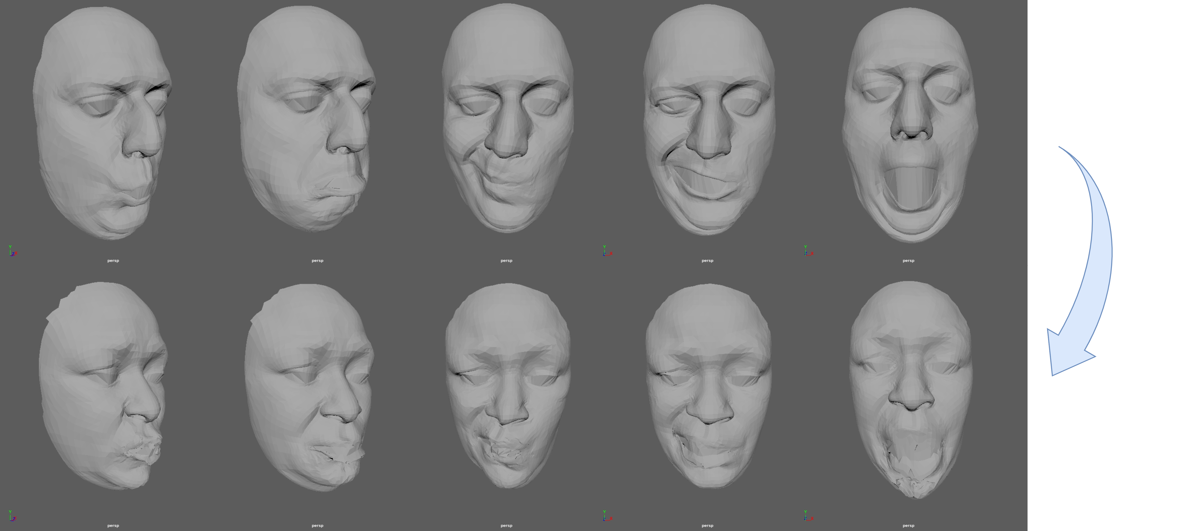
Facial Animation Retargeting by Unsupervised
Learning of Graph Convolutional Networks
Source
Result
Yuhao Dou and Tomohiko Mukai
Tokyo Metropolitan University
Notes:
Hello, My name is Yuhao Dou. Today, we will introduce our research Facial Animation Retargeting by Unsupervised Learning of Graph Convolutional Networks.

Slide 2
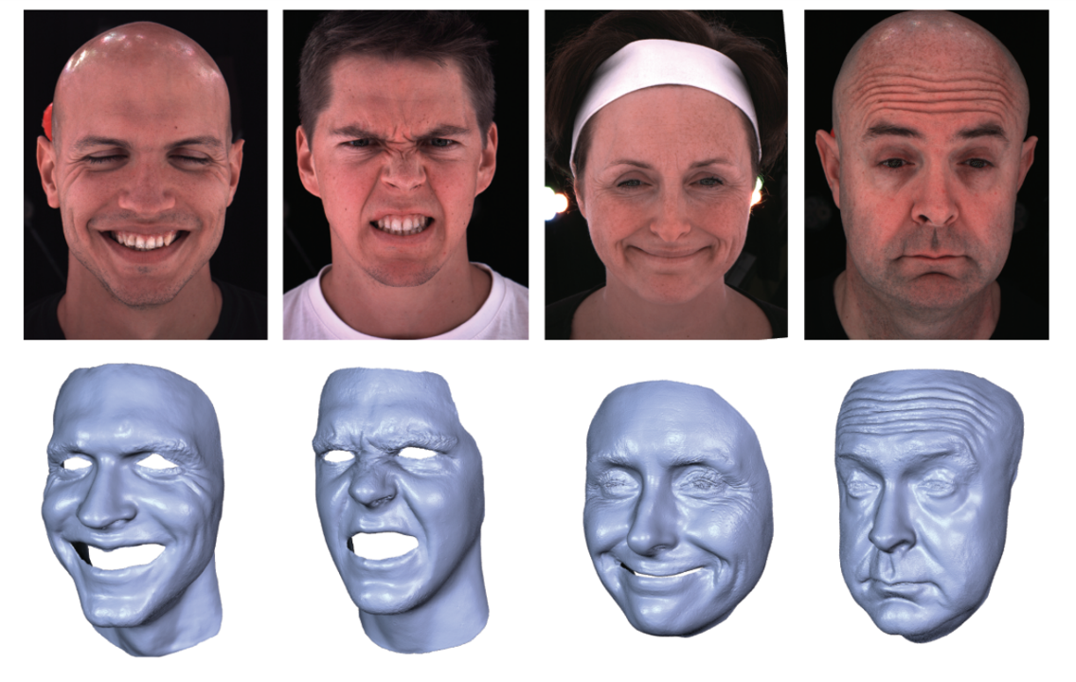
Facial Animation Retargeting by Unsupervised Learning of Graph Convolutional Networks
Background
High-quality facial animations
Highend game and films
The challenges in production
The high cost of facial capture
Expensive workload of manual editing by animators
[Cao et al. 2015]
Notes:
Facial expressions of virtual avatars play an essential role in the narrative of digital content, such as movies and games. Even though a high-fidelity facial capture system is available, producing believable facial animation requires an expensive workload to manually edit the keyframed or captured facial animations by experienced 3D animators.

Slide 3
Facial Animation Retargeting by Unsupervised Learning of Graph Convolutional Networks
Purpose
Transferring the existing facial animations to various characters
Reducing production workload through the reuse of data
Source animation
Target model
Retargeting result
Notes:
Many approaches have been proposed to improve the efficiency of facial animation production. Animation retargeting is a typical technique to eliminate the need for facial capture and manual editing by transferring existing animations of a source character to target characters.

Slide 4
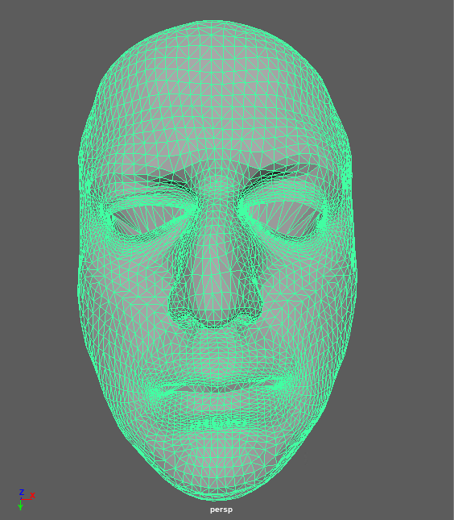
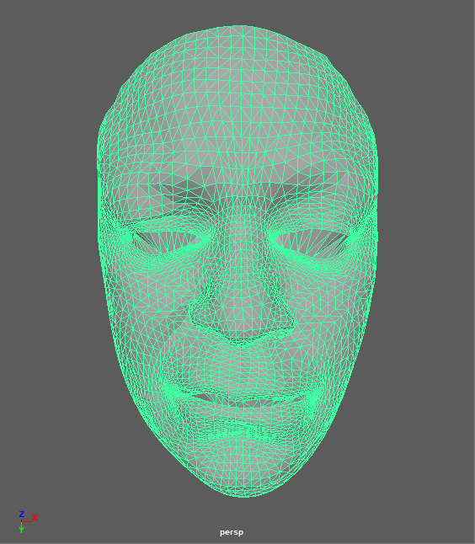
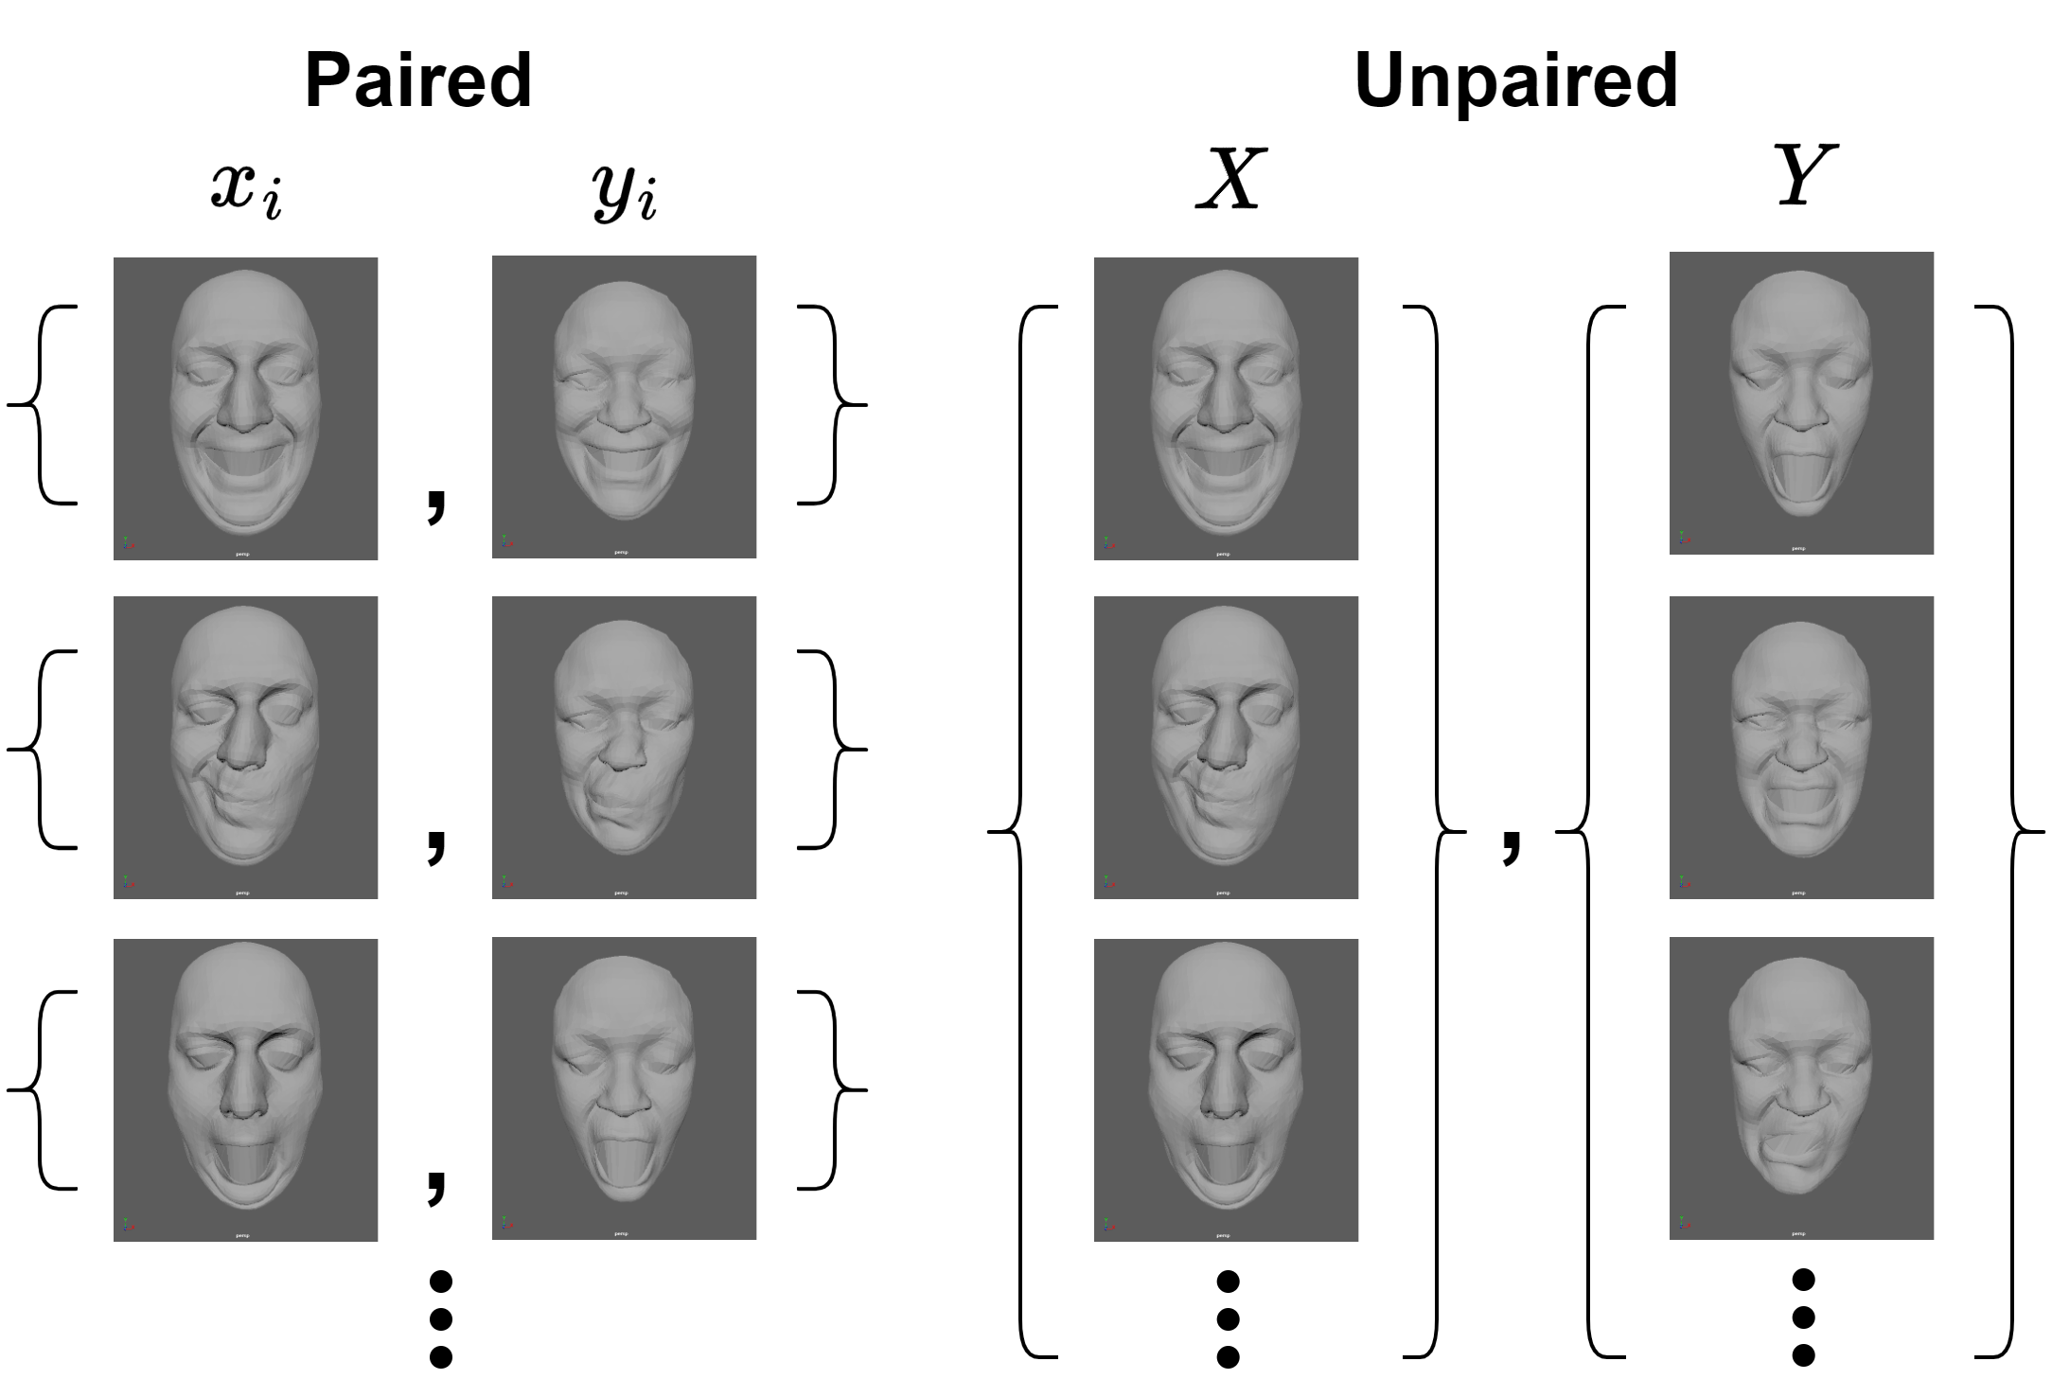
Facial Animation Retargeting by Unsupervised Learning of Graph Convolutional Networks
Goal
Enable transferring facial deformation to different facial mesh structures
Enable facial animation retargeting without paired training data
Notes:
This study tries to overcome two challenges in traditional facial retargeting.
The first is enabling the transferring facial deformation with different mesh structures.
And the second is eliminating the need for paired facial animation data.
In this study, we proposed a framework for training an unsupervised neural network with unpaired animation data.

Slide 5
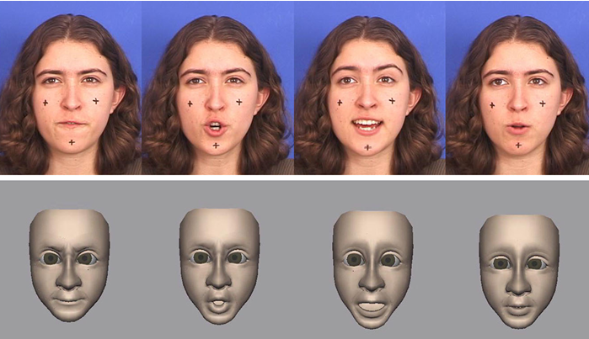
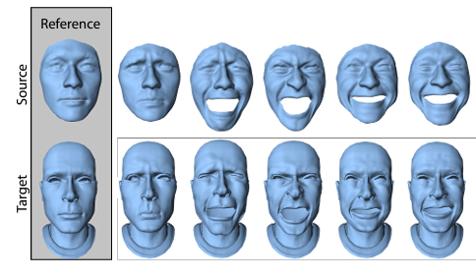
Facial Animation Retargeting by Unsupervised Learning of Graph Convolutional Networks
Related Work
Blendshape-based facial retargeting
The creation of the paired blendshapes
[Chuang et al.] 2002]
Deformation transfer
The accuracy of surface correspondence between the source and target models
Deformation Transfer[Sumner,et al. 2004]
Notes:
There are many studies about facial retargeting.
Blendshape-based facial retargeting has been widely used for estimating optimal blendshape parameters to best approximate a source face expression. However, these methods need The creation of the paired blendshapes.
Another method is Deformation transfer， WHICH is used to generate a target facial expression by transferring the deformation gradient of the source animation.
The quality of this method largely depends on the accuracy of surface correspondence between the source and target models.

Slide 6
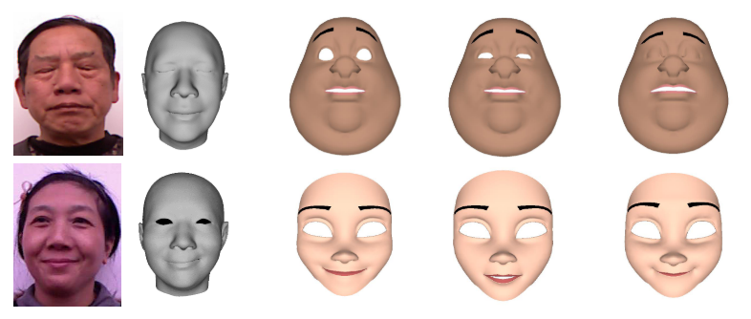
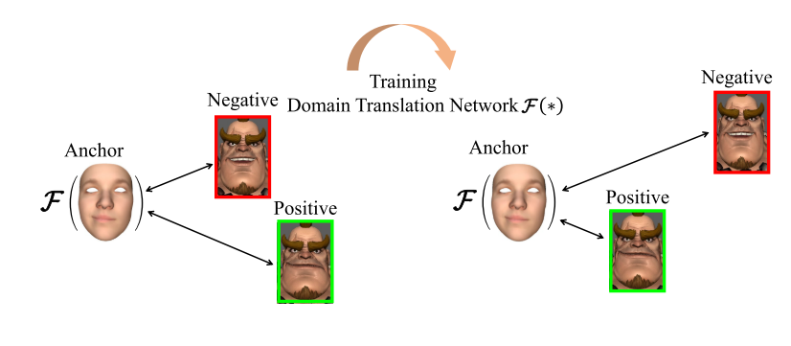
Facial Animation Retargeting by Unsupervised Learning of Graph Convolutional Networks
Related Work
Studies based on deep neural networks
Paired data is necessary
Motion retargeting between characters with different skeletal structures
The tops are the result of retageting.
The bottoms are the process of data annotation.[Zhang et al.] 2020]
Skeleton-aware network[Aberman,et al. 2020]
Notes:
There are studies based on neural networks for facial animation. However, existing methods require paried data for training, leading to increased data anotation costs. In this study, we propose an unsupervised framework to retarget facial animation to other characters using unpaired animation data. The proposed framework is inspired by the skeleton-aware retargeting for characters motion. Skeleton-aware Network is a method for retargeting motion data between characters with different skeletal structures.

Slide 7
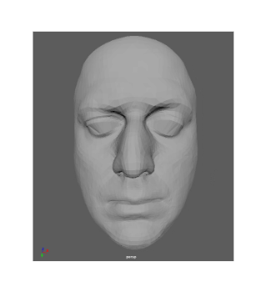
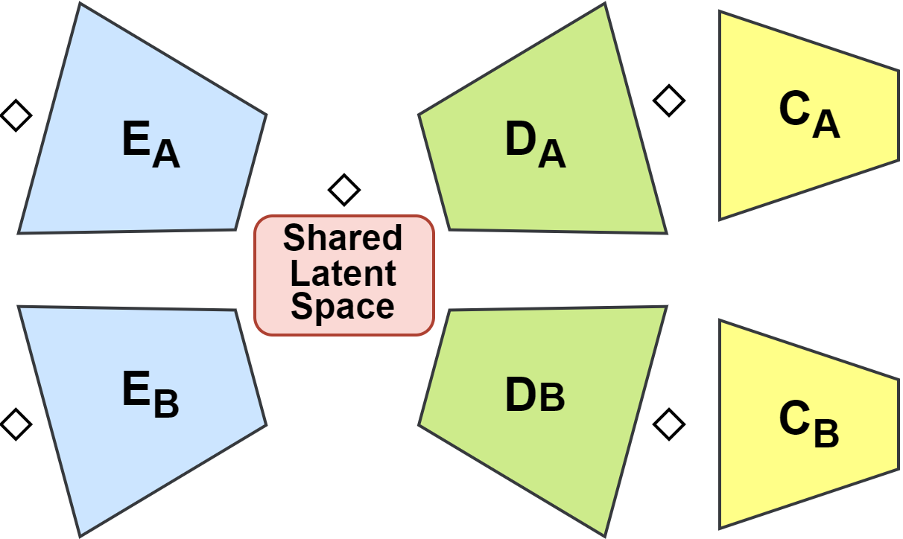
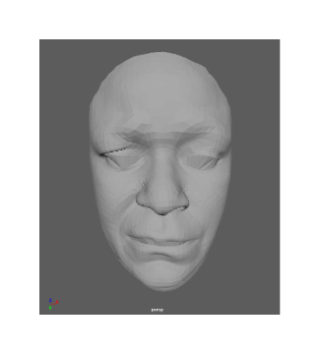
Facial Animation Retargeting by Unsupervised Learning of Graph Convolutional Networks
Method
A branching structure of two parallel autoencoders
The structure of network
Character A
Source model
Character B
Target model
Combination of autoencoder and GAN
Notes:
Our method uses a branching structure of two parallel autoencoders and a variant of GAN. The Autoencoder serves as the generator of the GAN, creating the transferred animation. The discriminator distinguishes whether the generated result is real or fake.
Pleasese note this presentation explains the retargeing from source character A to target character B.

Slide 8
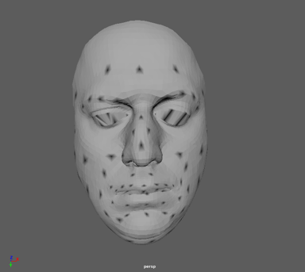
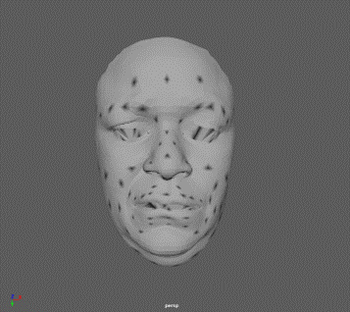
Facial Animation Retargeting by Unsupervised Learning of Graph Convolutional Networks
Method
Facial landmarks
Pooling mesh with different topologies using the corresponding landmarks
Projecting into the common latent space
：Landmark node
Black dot：landmark
Notes:
To handle characters with different mesh structures, we defines multiple landmarks for Graph Pooling. The adjacent vertices of the two mesh are merged into common landmark node, simplifying models into the same topology. The shared latent codes are obtained by graph pooling operators, and the character face is reconstructed from the latent codes by the unpooling operators. This allows the retargeting to be performed in the same latent space.

Slide 9
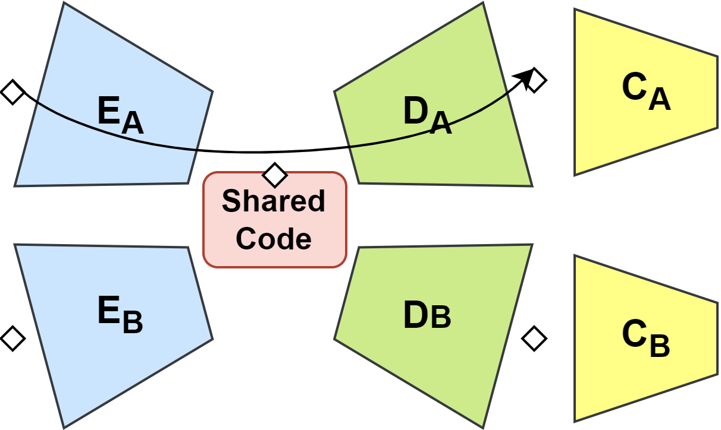
Facial Animation Retargeting by Unsupervised Learning of Graph Convolutional Networks
Method
Loss function：Reconstruction Loss
Note: These describe only the process of A → B retargeting, while the training of B → A retargeting is symmetric.
Notes:
The loss function of the network proposed in this study consists of three components. First, the reconstruction loss is the standard loss for the Autoencoder. It ensures the generation ability to accurately reproduce the same mesh structure.

Slide 10
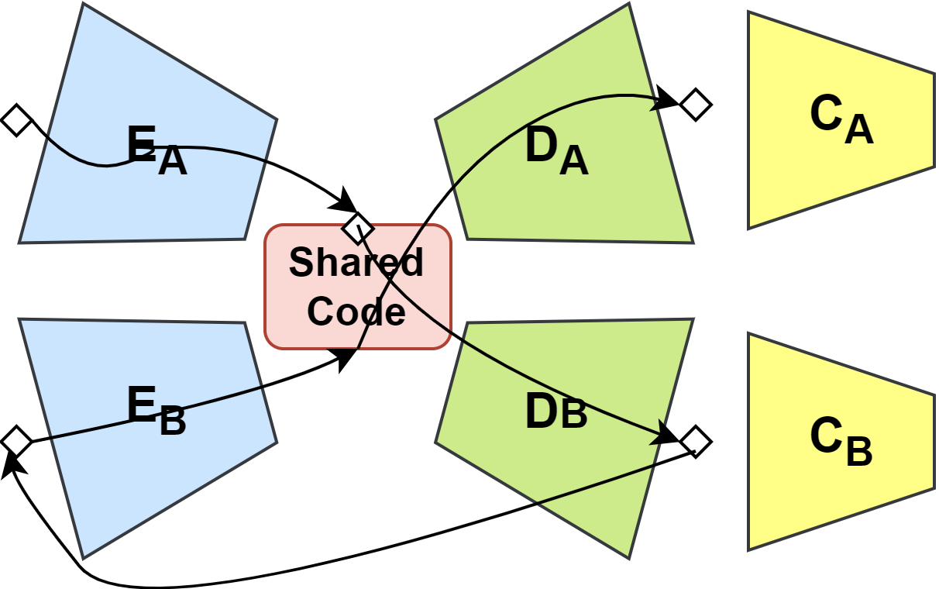
Facial Animation Retargeting by Unsupervised Learning of Graph Convolutional Networks
Method
Loss function：Cycle Consistency Loss
Notes:
And the Second loss item is the cycle consistency loss. This loss guarantees that the retargeting animation from the source model to the target model and then retarget back to the source model remains consistent.

Slide 11
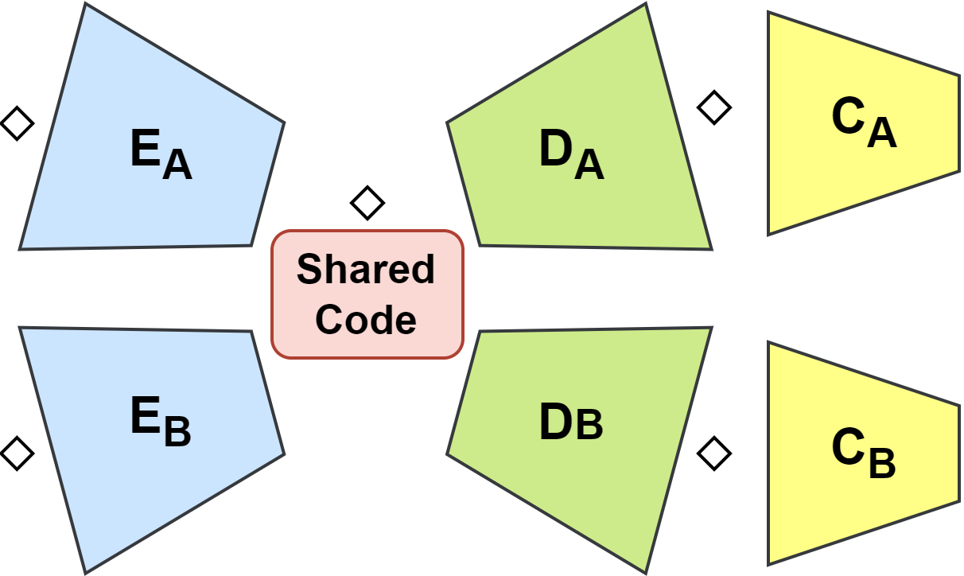
Facial Animation Retargeting by Unsupervised Learning of Graph Convolutional Networks
Method
Loss function：Adversarial Loss
Notes:
Finally, the adversarial loss is also the standard loss used in GANs. It enhances the generator's ability to produce high-quality results by ensuring that the discriminator can distinguishes between real and generated results.

Slide 12
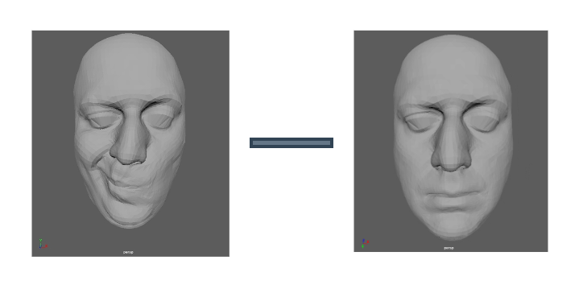
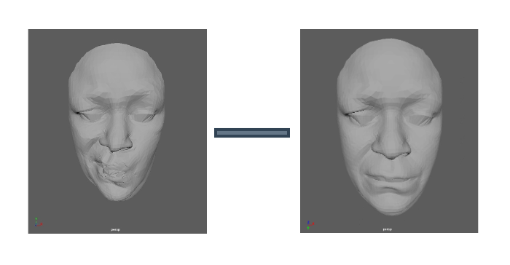
Facial Animation Retargeting by Unsupervised Learning of Graph Convolutional Networks
Method
Input
Delta Face：The difference between facial expression and neutral face
Output
Retargeting Delta Face
Notes:
In our network, We use Delta Face as the input. Delta Face is the difference between facial expression and neutral face. And the network output is the retargeting delta face.

Slide 13
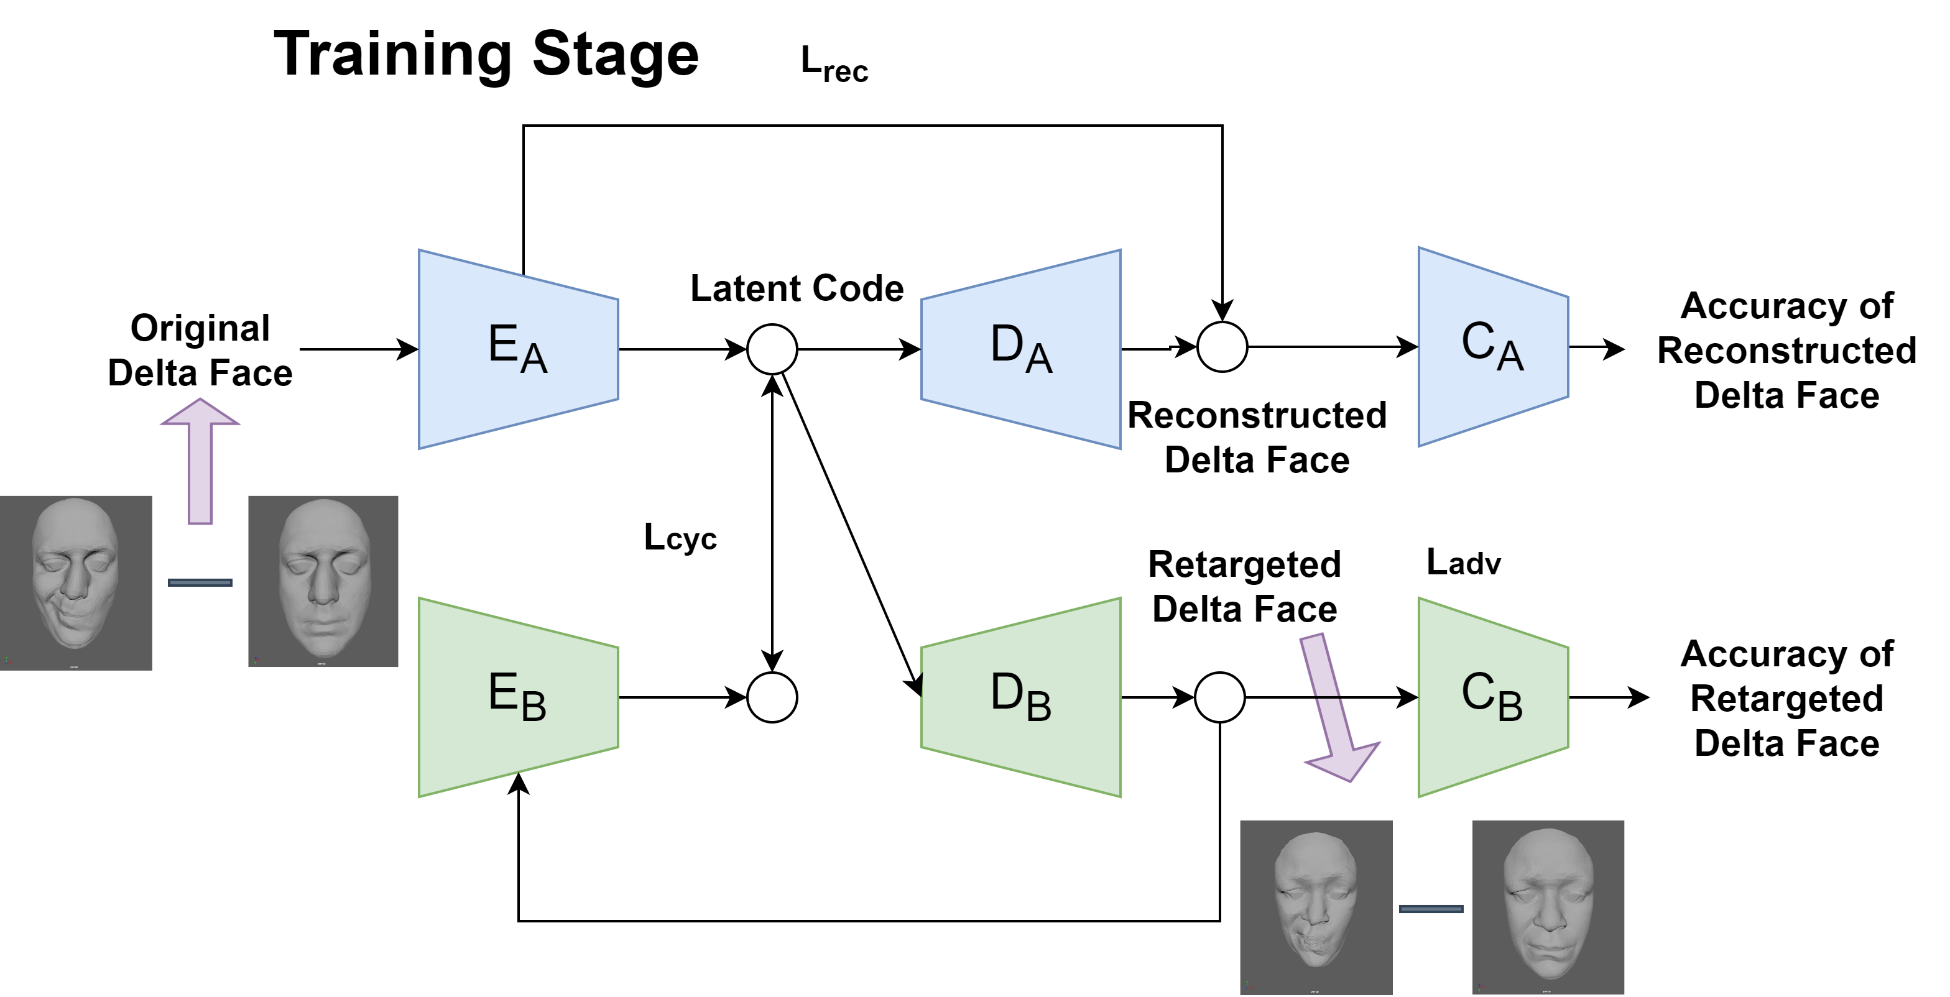
Facial Animation Retargeting by Unsupervised Learning of Graph Convolutional Networks
Method
Notes:
The overview of the training stage of the retargeting from the source character A to the target B is shown in this figure. The facial deformation of source character is encoded by encoder EA into the latent code. Then, decoder DA reconstructs the facial movement of the source character via Reconstruction Loss. The retargeting is achieved by feeding the latent code to decoder DB and the Cycle Consistency Loss is evaluated between the original latent code generated by encoder EA and the translated latent code by encoder EB.

Slide 14
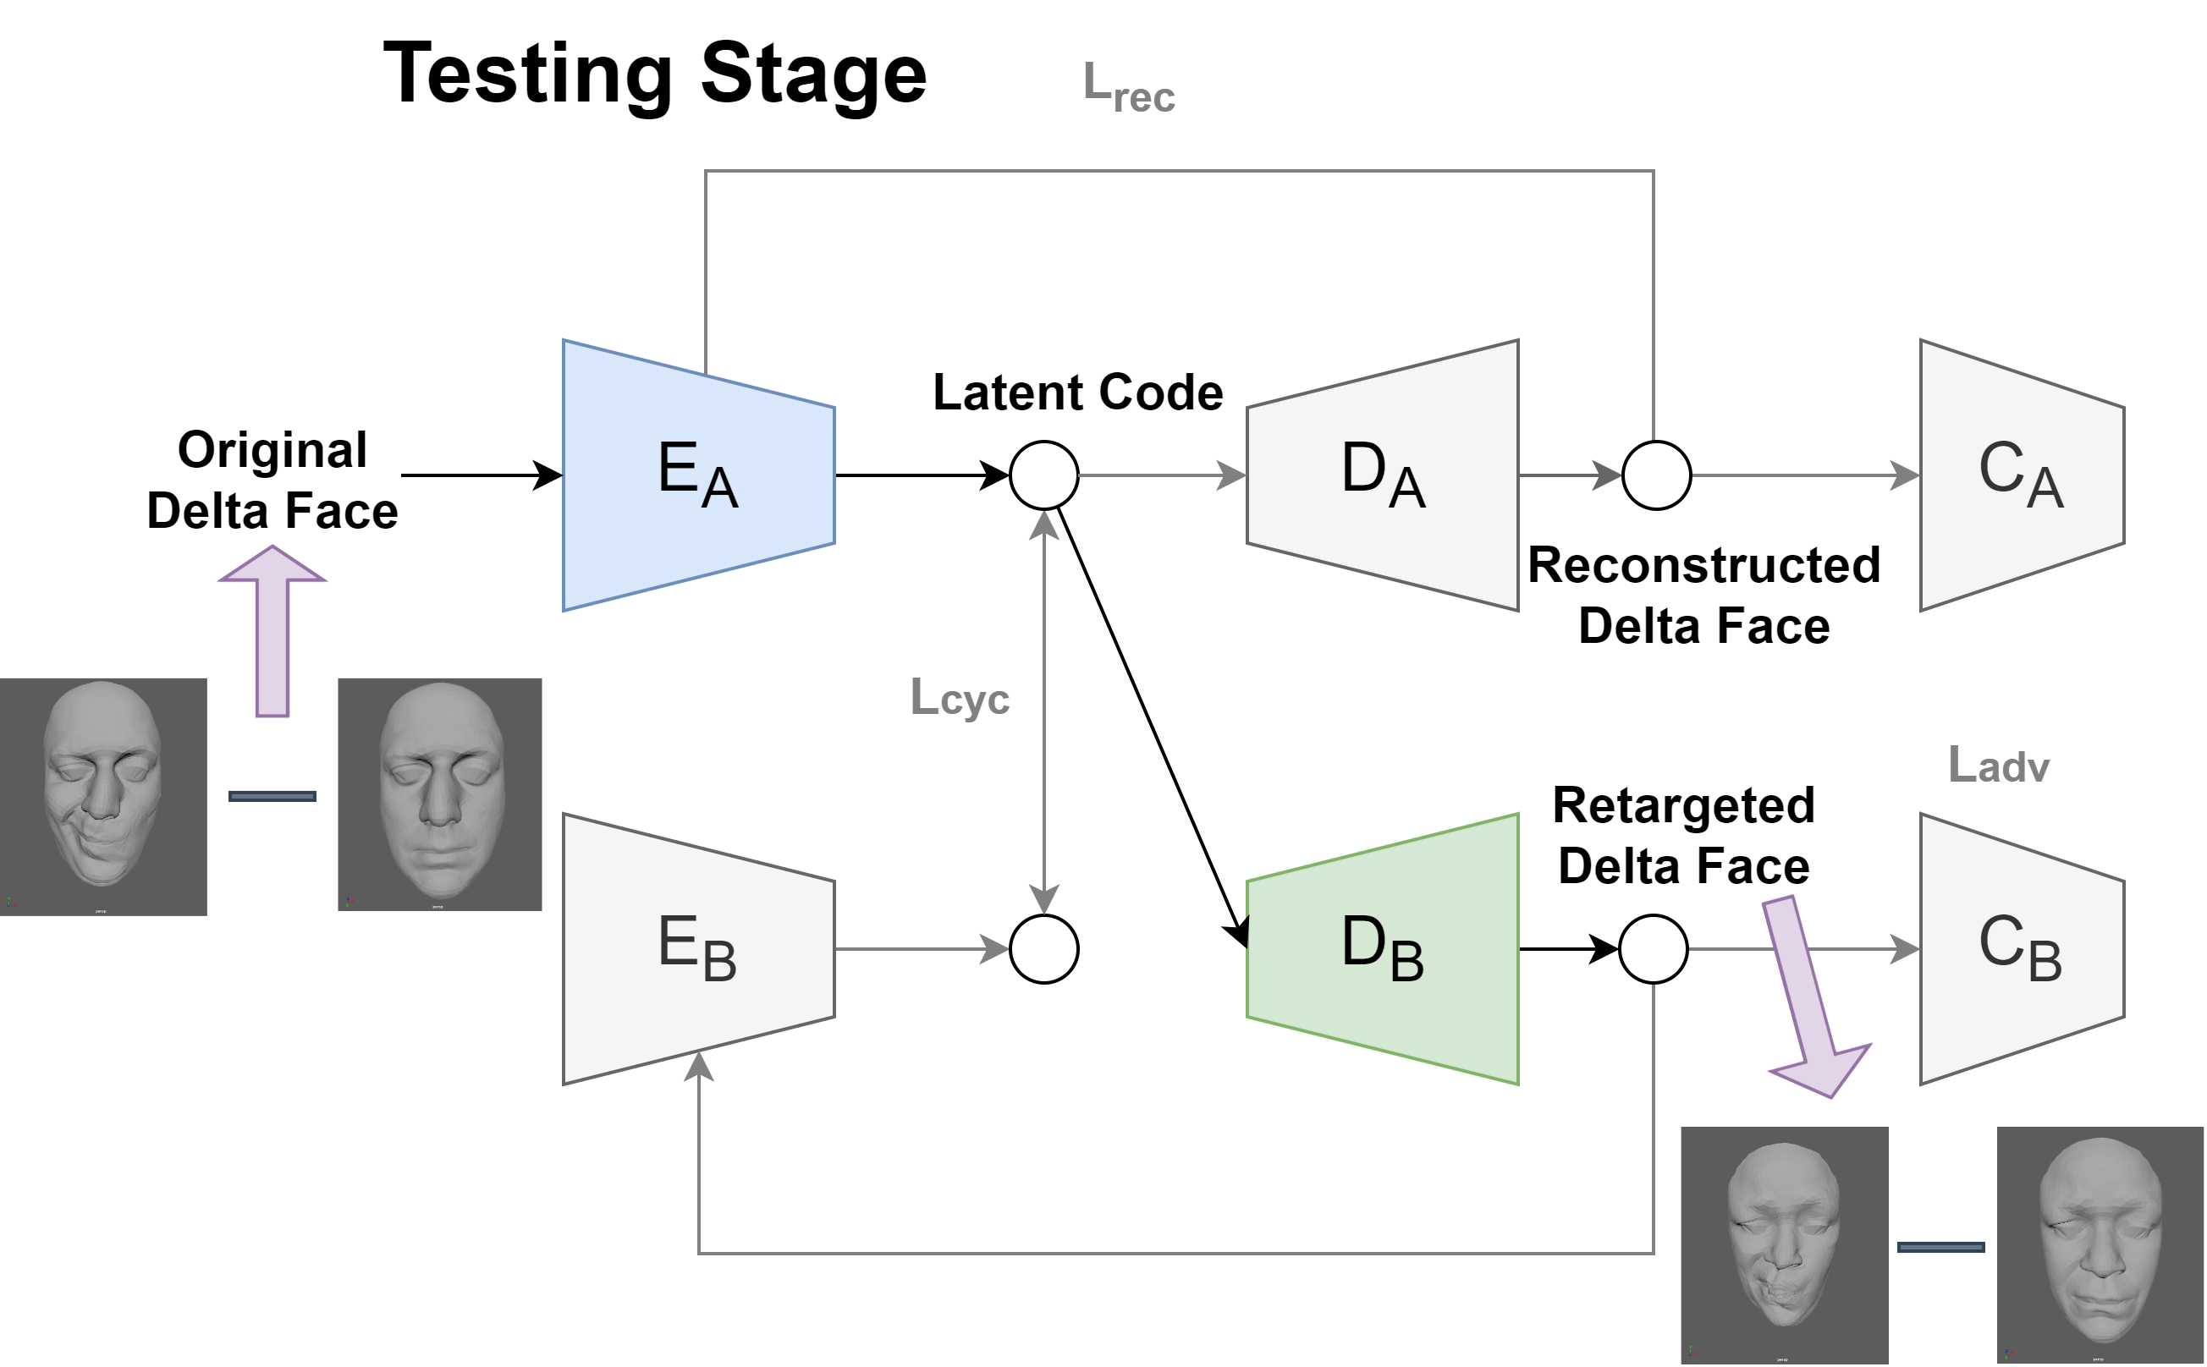
Facial Animation Retargeting by Unsupervised Learning of Graph Convolutional Networks
Method
Notes:
In the test stage, the trained network retargets facial expressions from A to B, Retargeting is achieved by using decoder DB to reconstruct the latent code generated by encoder EA.

Slide 15
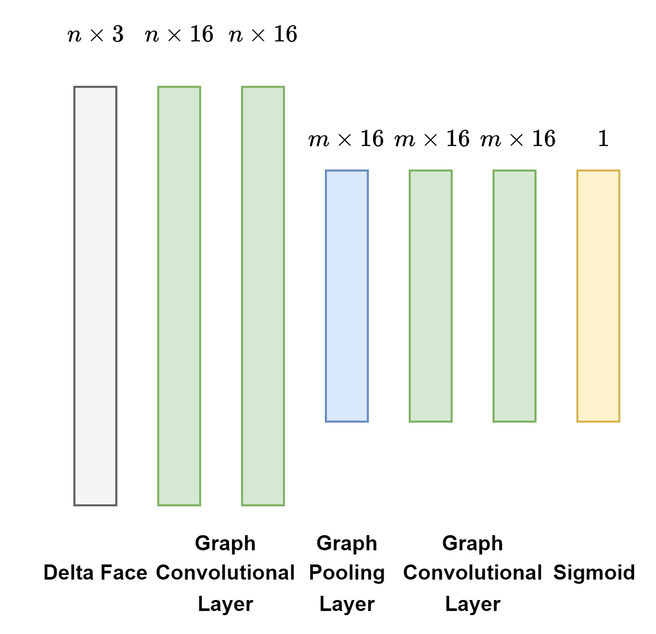
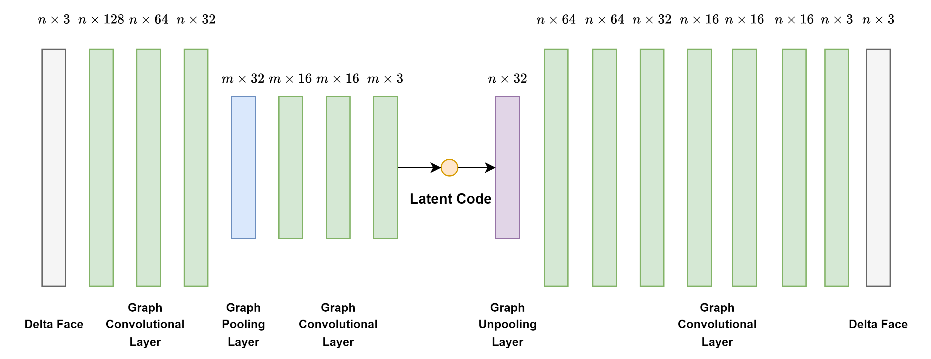
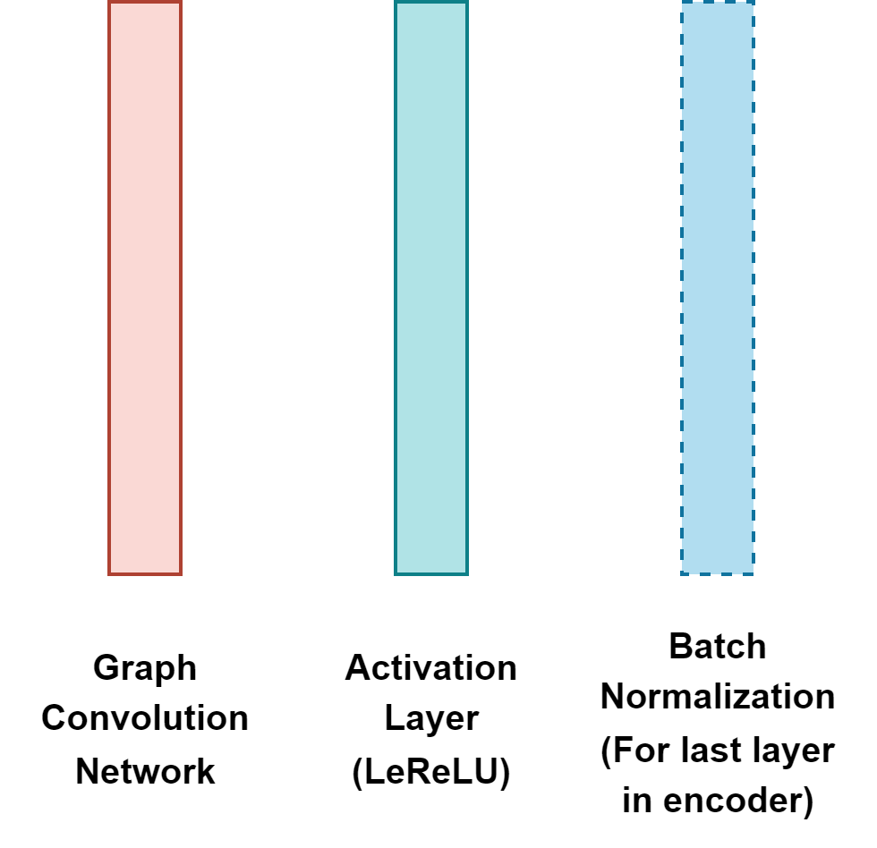
Facial Animation Retargeting by Unsupervised Learning of Graph Convolutional Networks
Method
Details of layers
Discriminator D
Generator G：Encoder and Decoder
Graph Convolutional layer
Notes:
The network is composed of two generators and two discriminators. Each generator consists of an encoder and a decoder. The generators and the discriminators include Graph Pooling and Unpooling middle layers.

Slide 16
Facial Animation Retargeting by Unsupervised Learning of Graph Convolutional Networks
Experiments
Used the Multiface dataset[Wuu et al. 2022] to train and test our framework.
Models in our experiments
Implementation details
Environment | Pygeometric
GPU | NVIDIA GeForce RTX 3080 GPU(10 GB)
CPU | AMD Ryzen 9 5950X/3.4GHz CPU(128 GB RAM)
Batch Size | 32
Training Time | 20h for 1000 epoch
Dateset Size | Entity 6795937: 3840 frames Entity 2183941: 3840 frames
Vertices: 3264
Entity: 6795937
Vertices: 3165
Entity: 2183941
Notes:
We used the Multiface dataset to train and test our framework.
The number of vertices for the two characters are around 3200. The dataset size for each characters is 3840 frames. Training takes 20 hours for 1000 epochs.

Slide 17
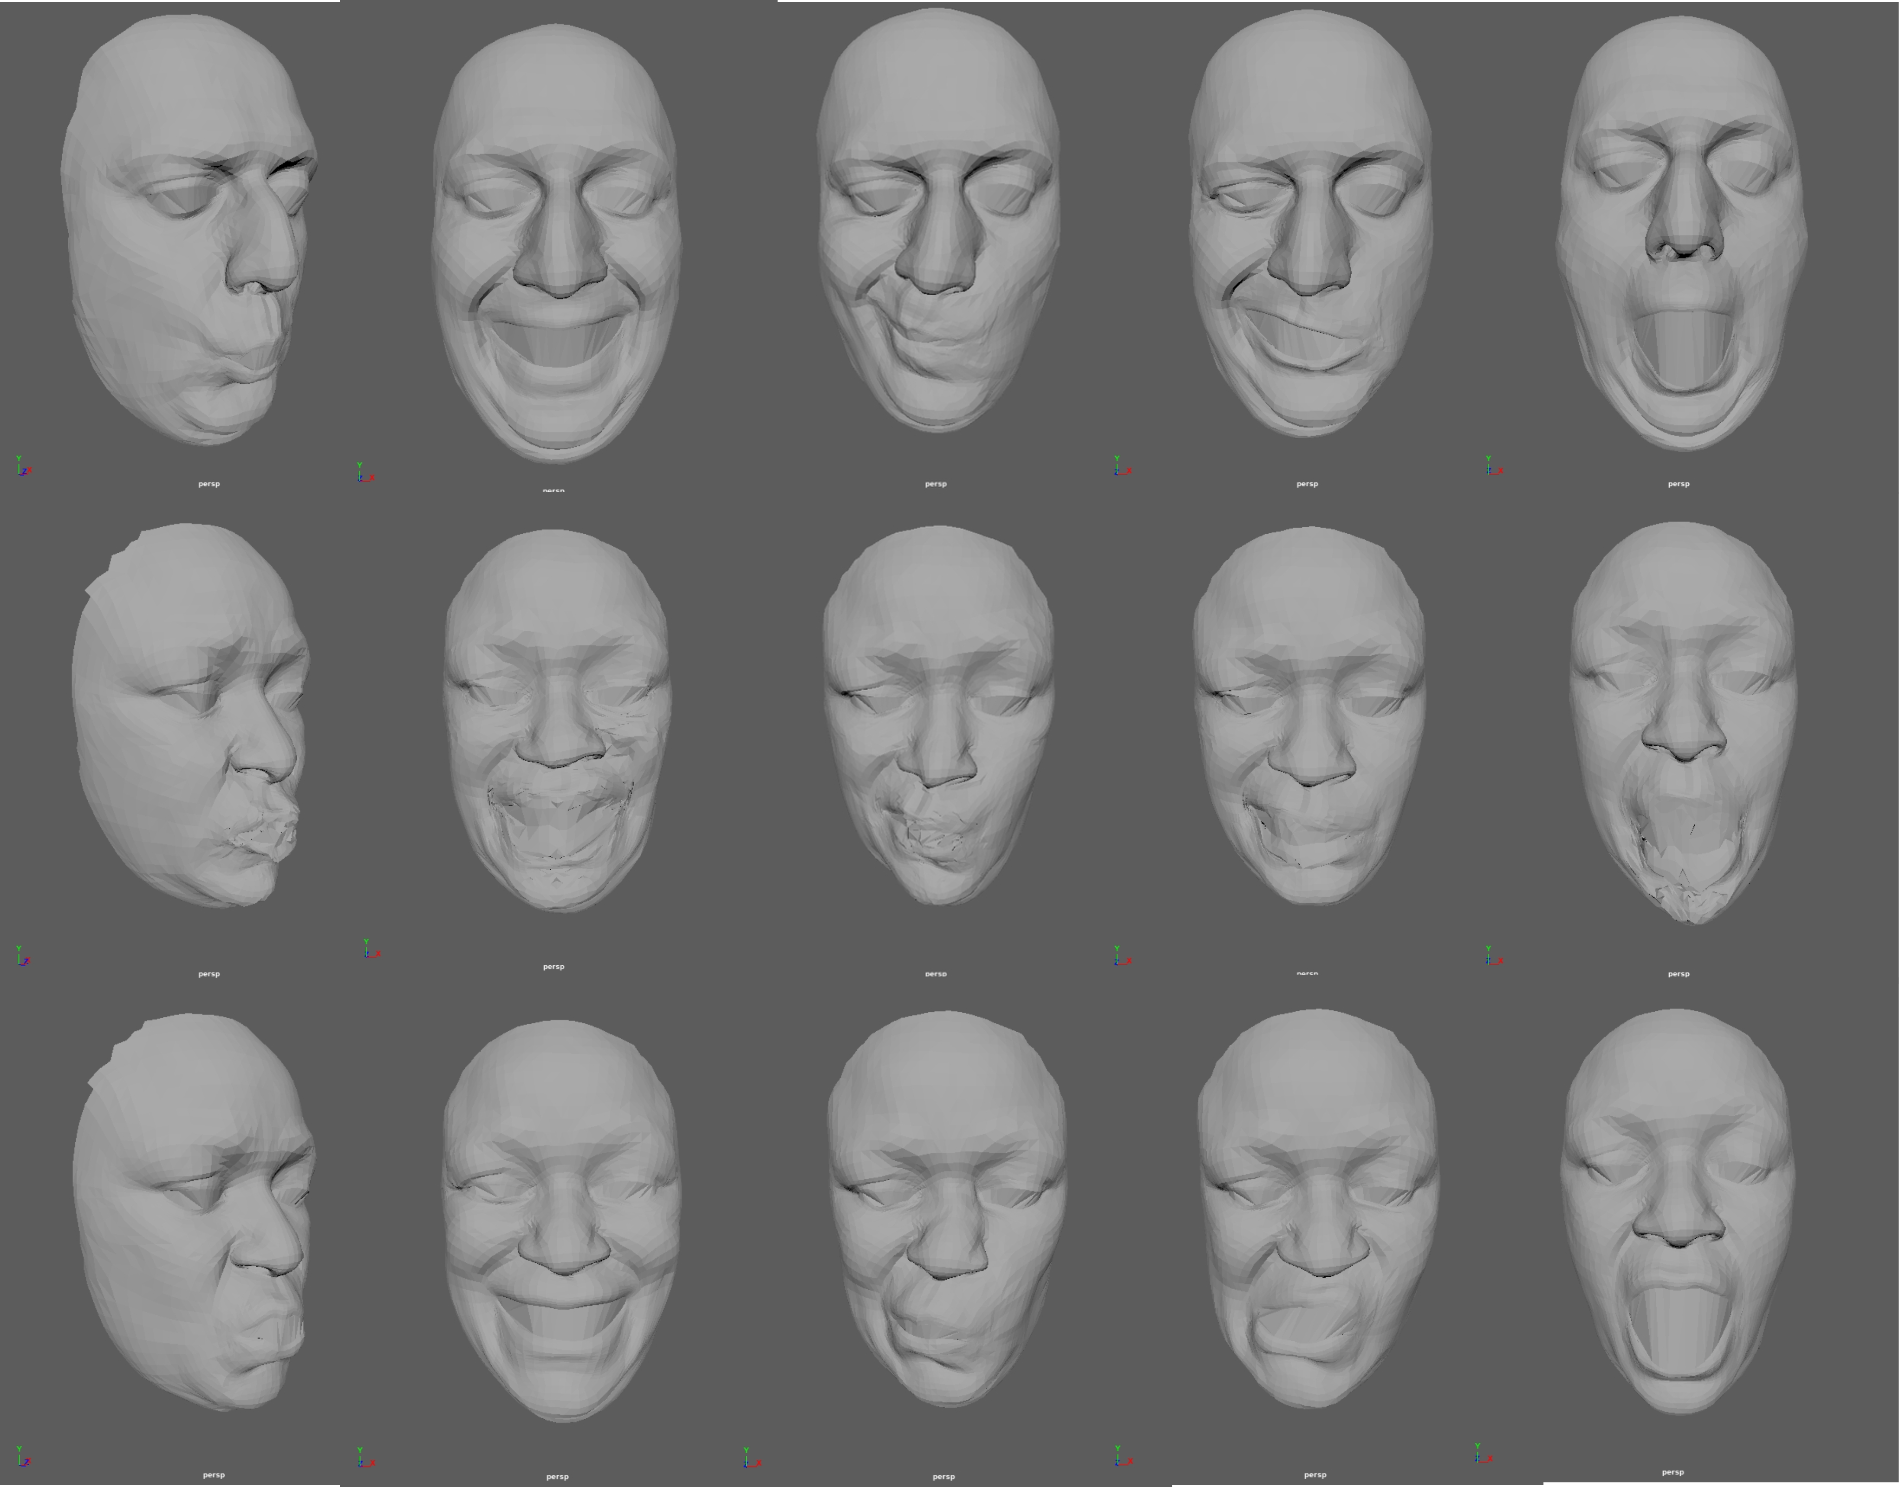
Facial Animation Retargeting by Unsupervised Learning of Graph Convolutional Networks
Experiments
Retargeting A➡B
Frame 9119 4060 15160 14281 18463
Source
Target
Ground Truth
Notes:
This is the retargeting result from Character A to Character B. The images from top to bottom are the source animations., the retargeting results and the reference GroundTruth for evaluation.
The images in the first Column is the expression pronouncing "Oooo".
The second Column is the expression of laughing .
The third Column is the expression of moving the mouth and nose to the right.
The fourth Column is the expression of opening the right side of the mouth.
The fifth Column is the expression of opening the mouth.

Slide 18
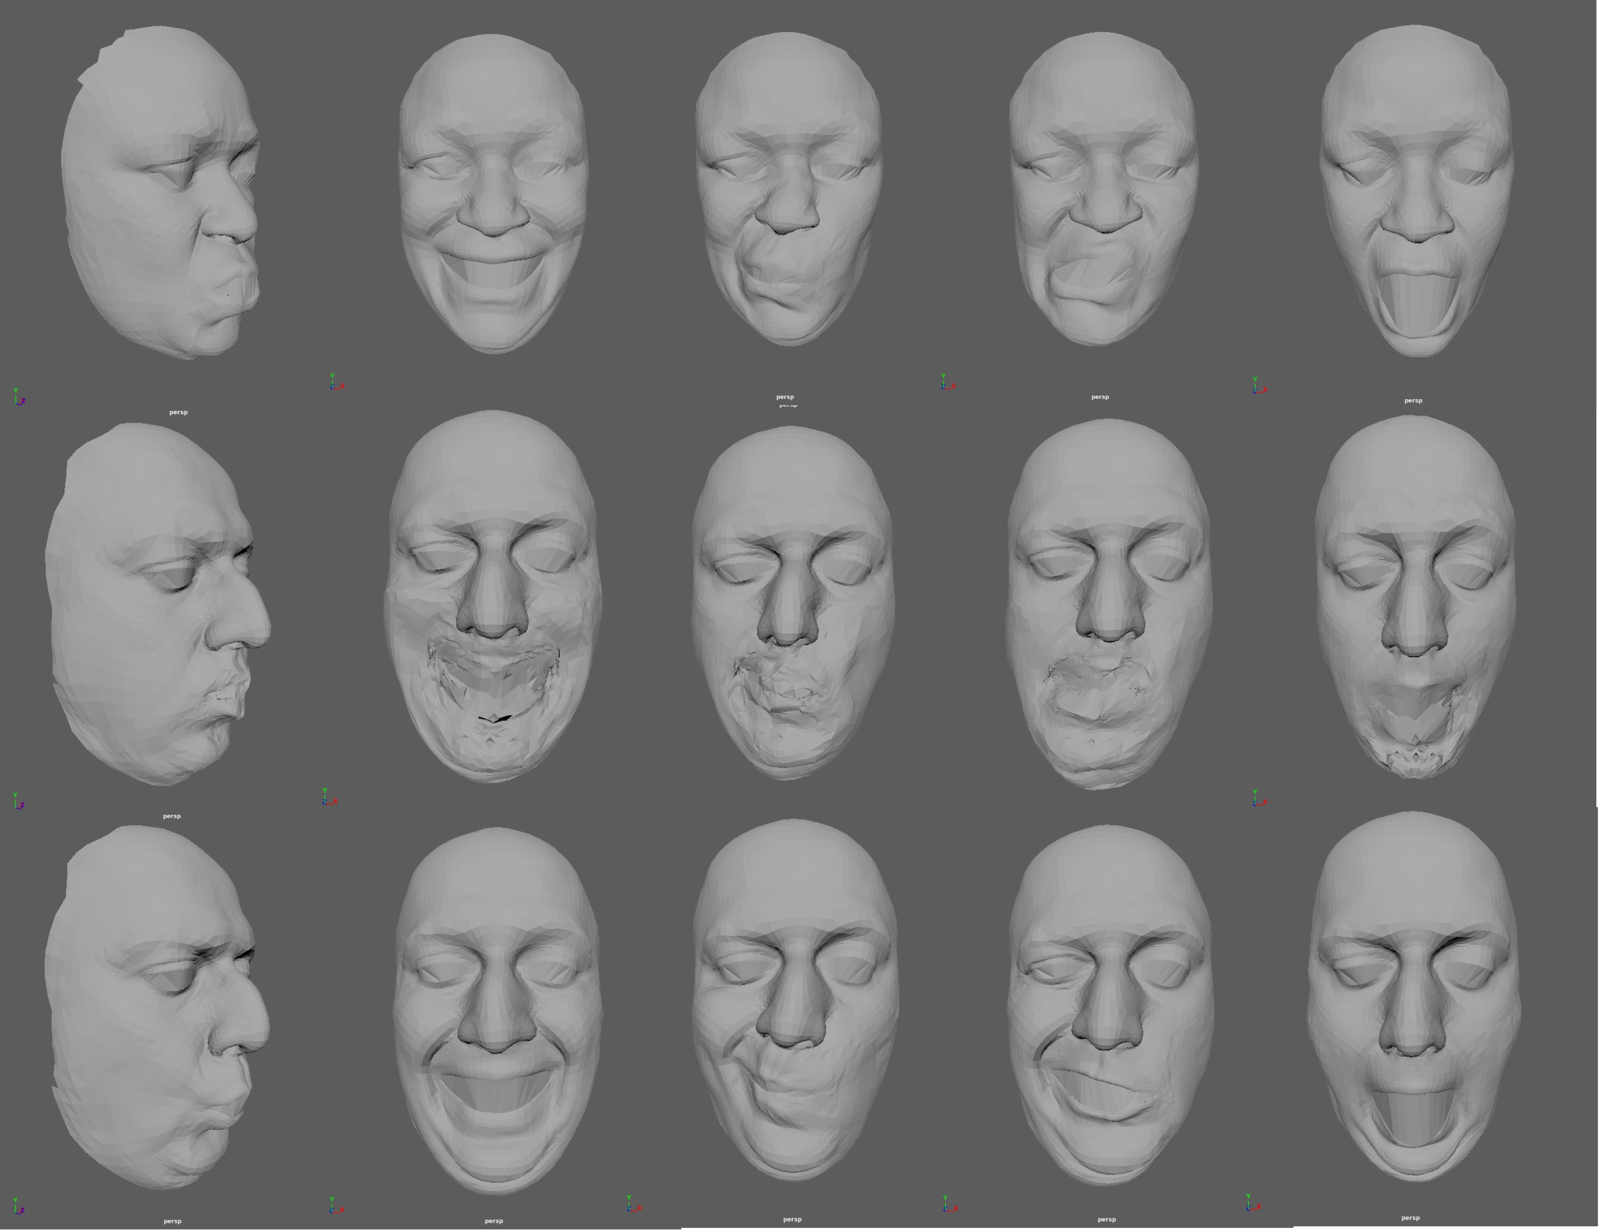
Facial Animation Retargeting by Unsupervised Learning of Graph Convolutional Networks
Experiments
Retargeting B➡A
Frame 20690 11987 29822 28927 33974
Source
Target
Ground Truth
Notes:
These images are the retargeting result from Character B to Character A.
These results verified that our method could retarget facial animation between two human characters with distinct
topologies when the facial deformation is not complex.

Slide 19
Facial Animation Retargeting by Unsupervised Learning of Graph Convolutional Networks
Experiments
Source Animation
Retargeting Result
Retargeting B➡A Mouth open
Notes:
This is the results animation.

Slide 20
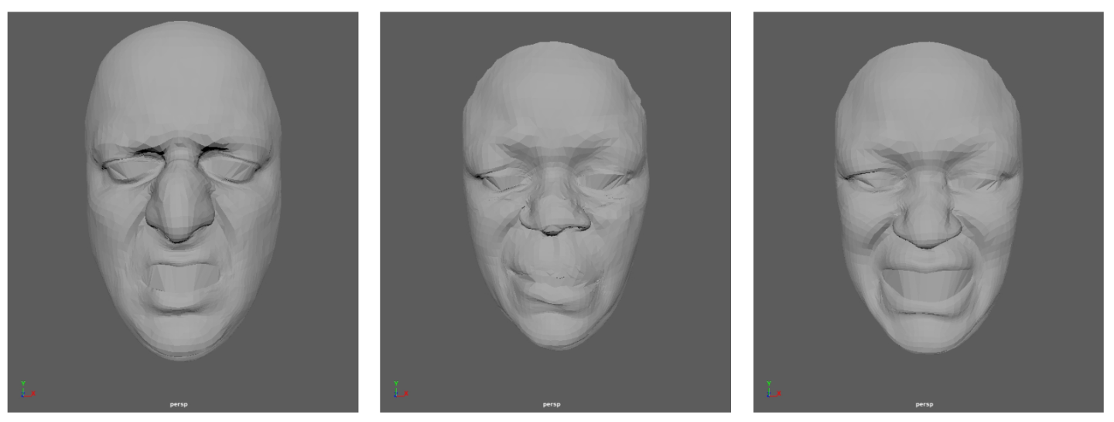
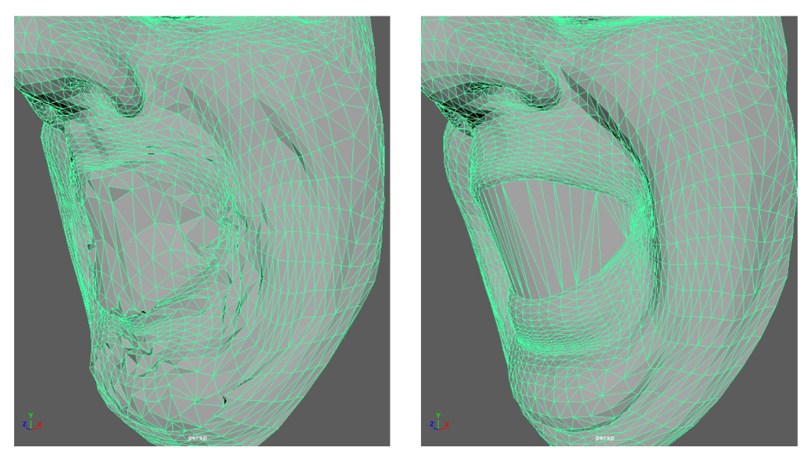
Facial Animation Retargeting by Unsupervised Learning of Graph Convolutional Networks
Experiments
The retargeting did not work for several expressions
Mesh vertices is averaged in the corresponding region
Unpooling averages the mesh vertices
Several results caused non-smooth artifacts
Did not consider the smoothness of mesh in our loss function
Notes:
The experimental results have several artifacts.
First, the retargeting did not work for several expressions.
Second, the feature in the landmark node is simply distributed to the adjacent nodes, so the generated deformation is averaged in the corresponding region.
Thirdly, the jaggy artifacts are generated in the retargeting results because the spatial smoothness is not considered in the loss function.

Slide 21
Facial Animation Retargeting by Unsupervised Learning of Graph Convolutional Networks
Conclusions
Method
An unsupervised framework for retargeting human facial animations to different characters.
Contributions
Transferring facial deformation to different facial mesh structures​
Training with unpaired data
Evaluation
Provides a reasonable estimation of a target facial expression that mimics a source characterMany artifacts cause the generated facial meshes
Notes:
We have proposed an unsupervised facial retargeting method for human characters to encode the human facial deformation into a common latent
space using graph pooling.
The proposed framework can reasonably retarget human facial animations between meshes with different topologies using unpaired facial animation data. However, the results of the retargeted animation still need to be improved since many artifacts cause the generated facial meshes.

Slide 22
Facial Animation Retargeting by Unsupervised Learning of Graph Convolutional Networks
Thanks for your listening
Q&A
Acknowledgement: JSPS KAKENHI 21K12193 & 21K19822, PlatinumGames Inc.
Notes:
Thanks for your listening.
If you have any questions, please do ask.

