Slide 1
Training Climbing Roses By Constrained Graph Search
Wataru Umezawa and Tomohiko Mukai
Tokyo Metropolitan University
Notes:
Today, I will introduce the procedural modeling method for climbing roses.

Slide 2
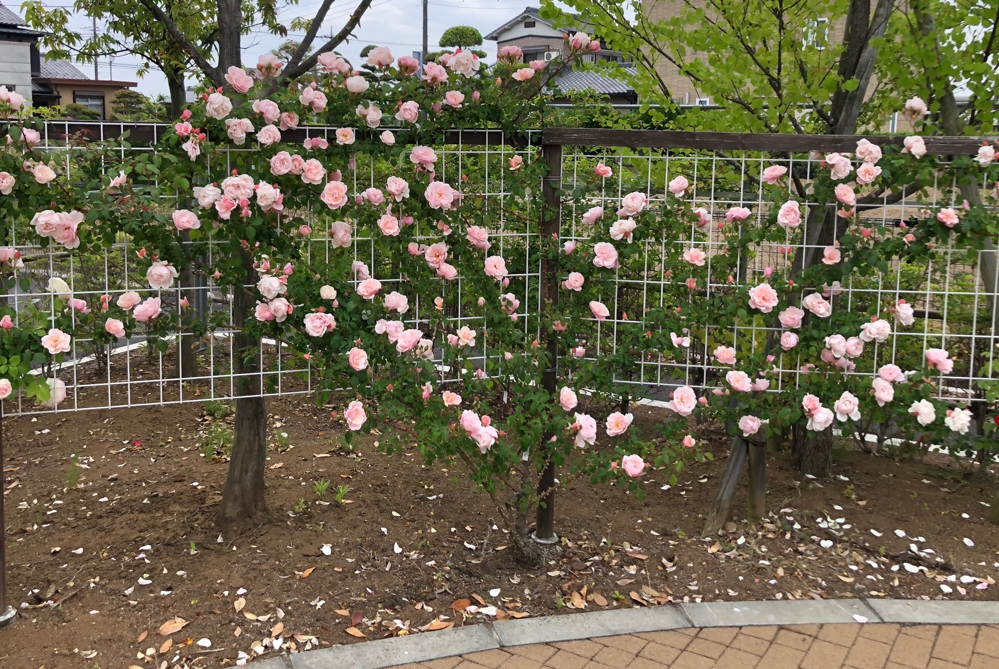
Introduction
Climbing rose tree: Arranged by manual fixing
Purpose
Procedural modelling method that do not require 3D artists to have knowledge of artificial cares and plant ecology
Method
Stems are generated by iterative path finding algorithm
Fix stems
to structures
Climbing rose
Natural tree shape
Manual arrangement
Notes:
Roses are often found in botanical gardens.
Gardeners make unique tree forms of climbing roses by manually fixing the stems on supporting structures.
This artificial care affects the tree shape, so knowledge of this care is necessary to create the convincing 3D models.
We propose a Procedural modelling method incorporating knowledge of artificial cares and plant ecology.
Our key idea is to use iterative path finding algorithm to generate the tree shape.
The knowledge about the rose planting is used to design the objective function and some constraints of the path finding algorithm.

Slide 3
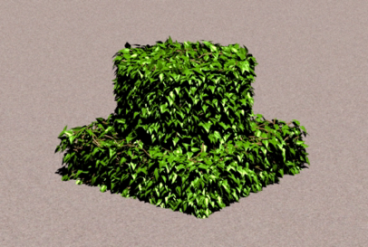
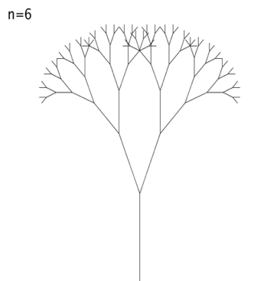
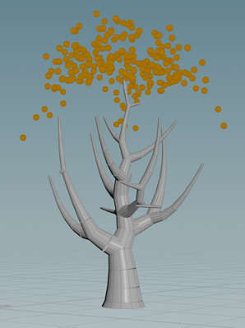
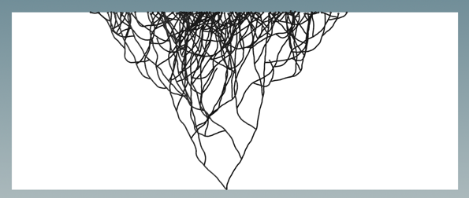
Rerated work(1)
2. Well maintained plants
Limited variety of target plants
General Trees
Mimicking the natural growth
L-System
[Aristid et al., 1990]
Space Colonization
Algorithm
[Runions et al., 2007]
Synthetic Topiary
[Prusinkiewicz et al., 1994 ]
3. Climbing plants
Considered the relationship between supporting structure and natural growth
L-System for climbing plants
[Johan et al., 2012]
They cannot generate well maintained plants
Notes:
Next, I will explain the related work
There are many procedural modeling methods for plants.
However, they cannot generate well maintained plants
For Example, Studies Aim at General Trees such as the L-system and the Space colonization algorithm, are based on natural plants growth.
Therefore, they are not adaptable to well-tended plants.
On the other hand, there are some methods that target well-maintained plants.
However, these methods are limited in the types of plants and care they supporting structure.
In addition, the methods for climbing plants only consider the relationship between support and natural growth.
So, they can not generate climbing roses that are manually fixed to supports by gardeners.

Slide 4
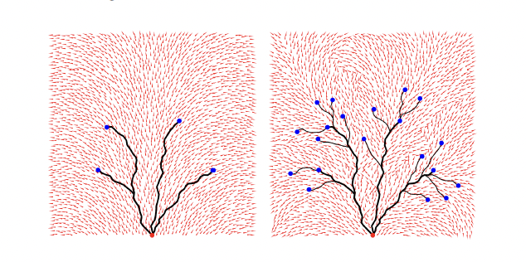
Rerated work(2)
Guiding Vectors Method
[Xu L, 2015]
Shrub Rose Method
[Umezawa W, 2023]
Generate natural tree models by path-finding algorithm
Shrub roses are not fixed to supporting structure
Notes:
Next, I will explain Two particularly relevant studies.
The Guiding vectors method generates natural trees by path finding algorithm.
Similar to our method, it generates a tree shape by iteratively solving a path search, where each branch is considered a path.
However, this method approximates naturally grown trees, whereas the proposed method approximates gardener’s care.
In our previous study, we proposed a procedural method for shrub roses.
This method takes into account the care that controls the branching of shrub roses, However, in the case of climbing roses, the stem curve is also controlled.

Slide 5
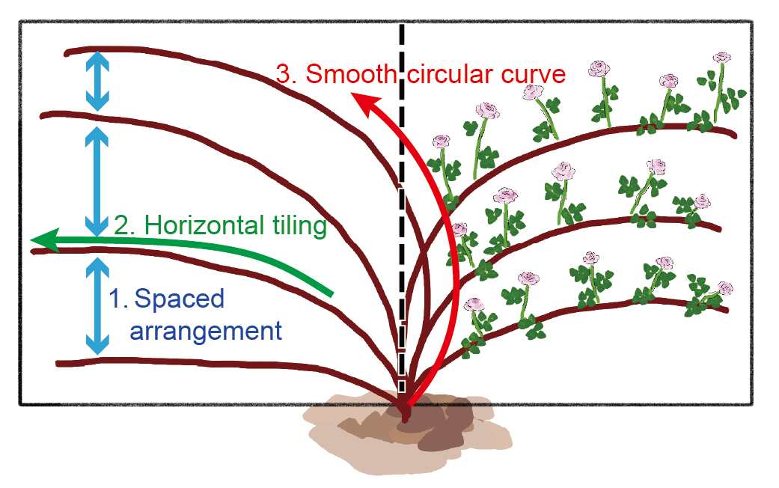
Climbing rose tree shape
Climbing rose tree are designed by artificial care
The care is called “training”, where gardeners fix roses to supporting structure
Training aims to enhance their aesthetic appeal by aligning the stems according to following these typical three criteria
Typical training criteria
1. Spaced arrangement : Flowers cover the entire support structure
2. Horizontal tiling: For maximum number of blooming flowers
3. Smooth circular curve : To avoid breaking stems
Notes:
The tree shape of climbing roses are designed by artificial care.
The care is called “training”, where gardeners fix roses to supporting structure
Training aims to enhance their aesthetic appeal by aligning the stems according to these typical three criteria
First criteria is Spaced arrangement : this ensures that the flowers cover the entire support structure.
The next is horizontal tiling: this is due to the feature of roses that makes it easier to increase the number of flowers in the horizontal part of the stems.
Finally, there is the smooth circular curve : This is because branches break when excessively bent.
The proposed method is focused on these three criteria.

Slide 6
Comparison of tree structure with conventional methods
✓
✓
Spaced stems
Horizontal tiling
Smooth curve
✓
✓
✓
✓
Notes:
This slide shows Comparison of tree structure with conventional methods.
The left one is our method.
Our method satisfies the tree training criteria.
The center shows the result of L-System-based method, and, the right is the result of the space colonization method.
These two conventional methods can`t satisfy all criteria, because their targets are natural plants.

Slide 7
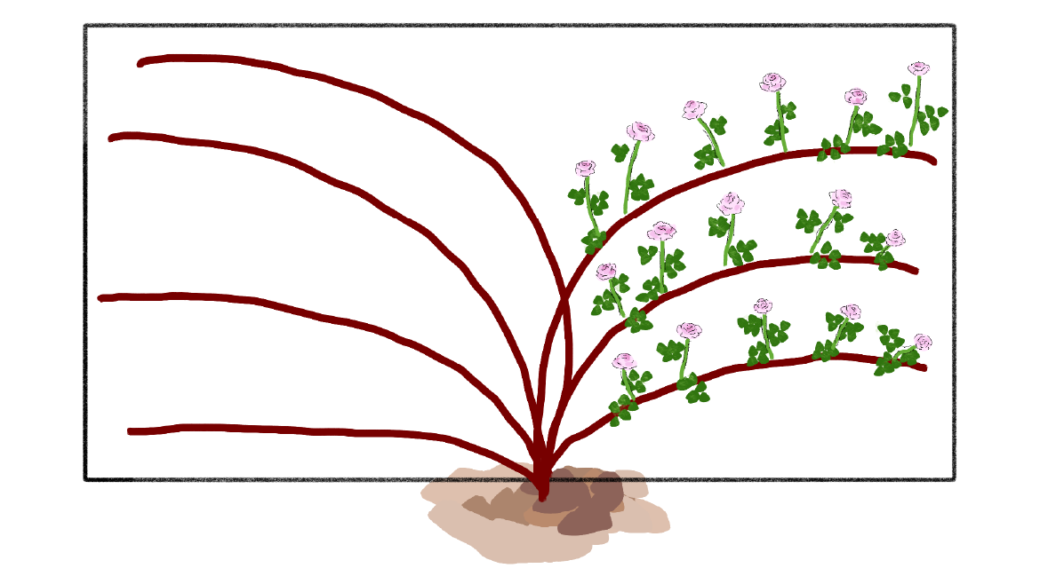
Algorithm
Two types branches :
Trained stems : Iterative path finding
Side shoots : Recurrently generating sections
Trained stems
Side shoots
Artificial care
No flowers and leaves
Sprout the spring following Training
Natural growth
They have flowers and leaves
Notes:
Next, I will explain the details of the proposed method
The proposed method classifies branches into two types:
Trained stems and side shoots.
Trained stems are generated by iterative path finding that mimicking training.
And they don’t have flowers and leaves.
Side shoots are generated by Recurrently generating sections.
They Sprout the spring following Training and grow without artificial cares.

Slide 8
Overview
The proposed method consists of three steps
1. Generate trained stems
2. Generate side shoots
3. Attach models
Notes:
The proposed method consists three steps
First, The proposed method generate trained stems.
This step consists two substeps: Roadmap construction and Iterative stem generation.
Second step is Generation of side shoots.
They occurs from the sufficiently horizontal stem segment.
The proposed method generates their sections recursively mimicking natural growth。
The Last step is the attachment of flower and leaf models.
In this talk, we will explain only the trained stem.
For the side shoot generation and the model attachment, please see the paper for the details.

Slide 9
Roadmap graph construction
Vertex generation
Wall
Generate vertices to cover the wall
Additional vertices around the root
Combining two groups of vertices
Remove vertices near the ground
Notes:
At the beginning of our method, the Roadmap graph is constructed on the supporting wall.
The roadmap graph vertices are generated in the following two substeps.

Slide 10
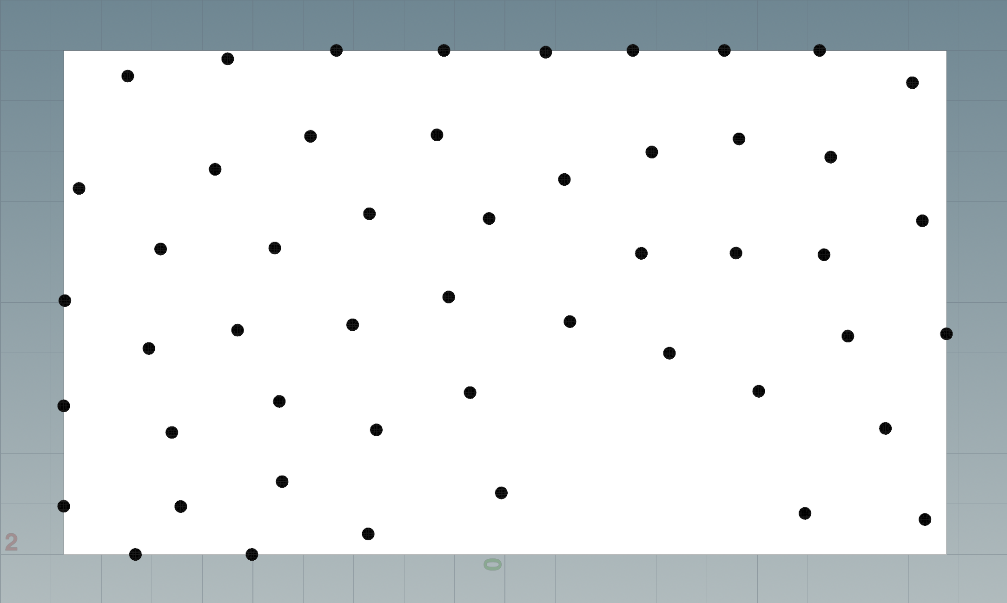
Roadmap graph construction
Vertex generation
Wall
Generate vertices to cover the wall
Additional vertices around the root
Combining two groups of vertices
Remove vertices near the ground
Notes:
First, vertices are (randomly) generated to cover the wall.

Slide 11
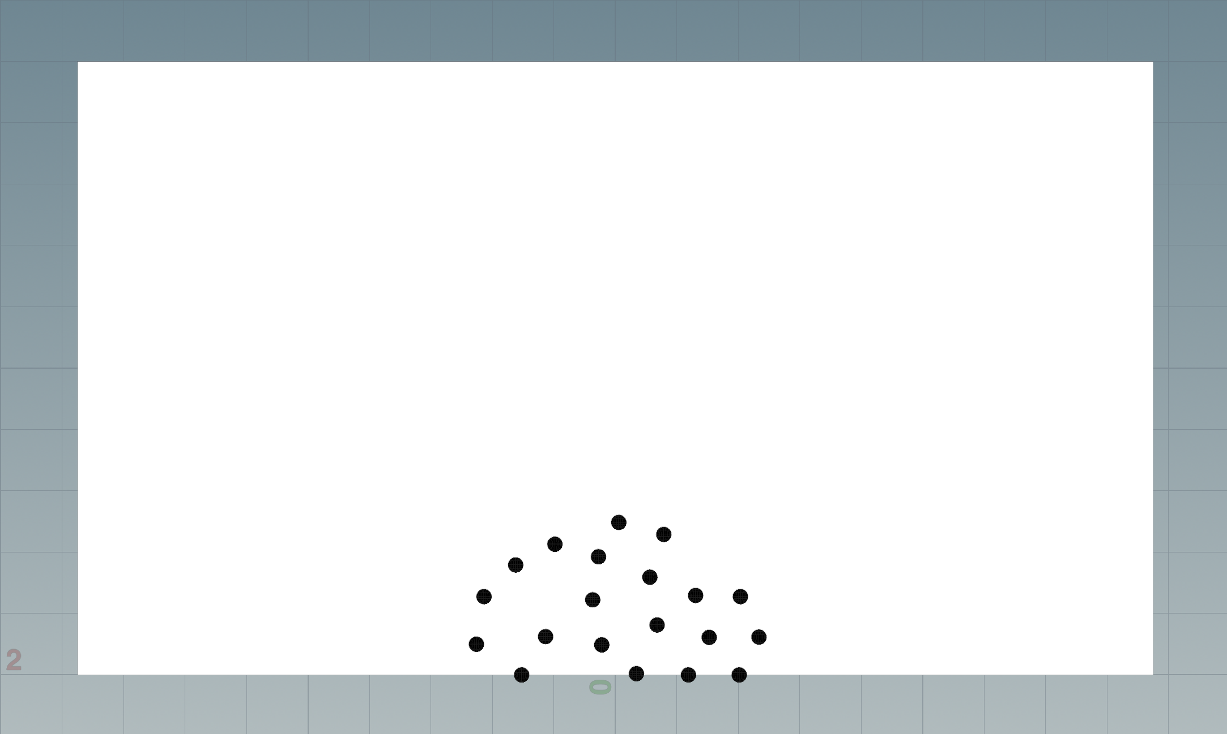
Roadmap graph construction
Vertex generation
Wall
Generate vertices to cover the wall
Additional vertices around the root
Combining two groups of vertices
Remove vertices near the ground
Notes:
Next , Additional vertices are generated around the root
This is because branches are crowded around the root
.

Slide 12
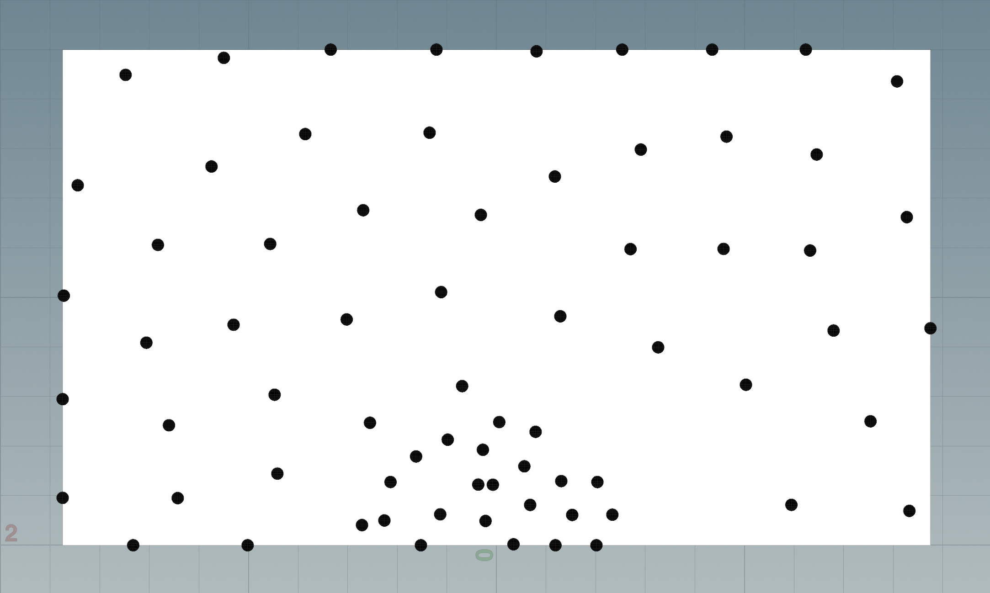
Roadmap graph construction
Vertex generation
Wall
Generate vertices to cover the wall
Additional vertices around the root
Combining two groups of vertices
Remove vertices near the ground
Notes:
Then, the two group of vertices are combined.

Slide 13
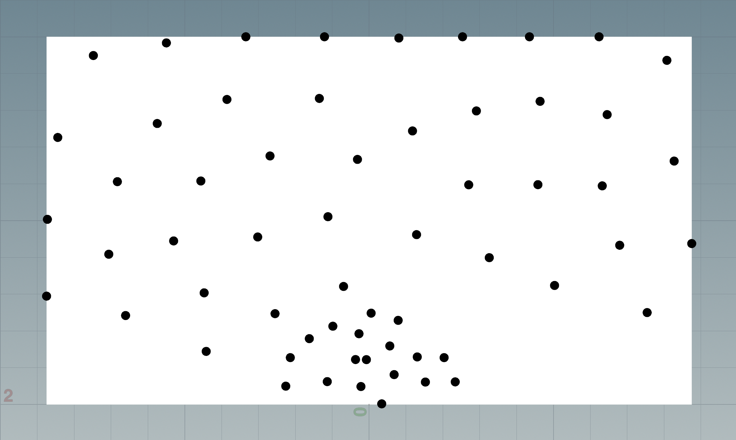
Roadmap graph construction
Vertex generation
Wall
Generate vertices to cover the wall
Additional vertices around the root
Combining two groups of vertices
Remove vertices near the ground
Notes:
Finally, the proposed method removes vertices near the ground to avoid to Generate branches that are too close to the ground.

Slide 14
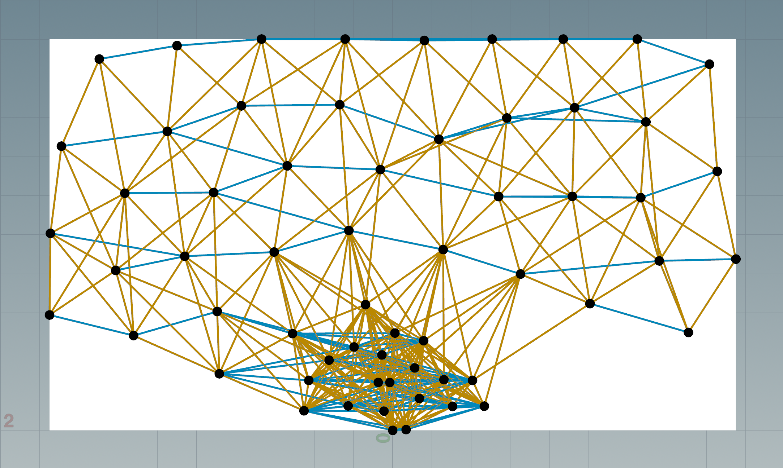
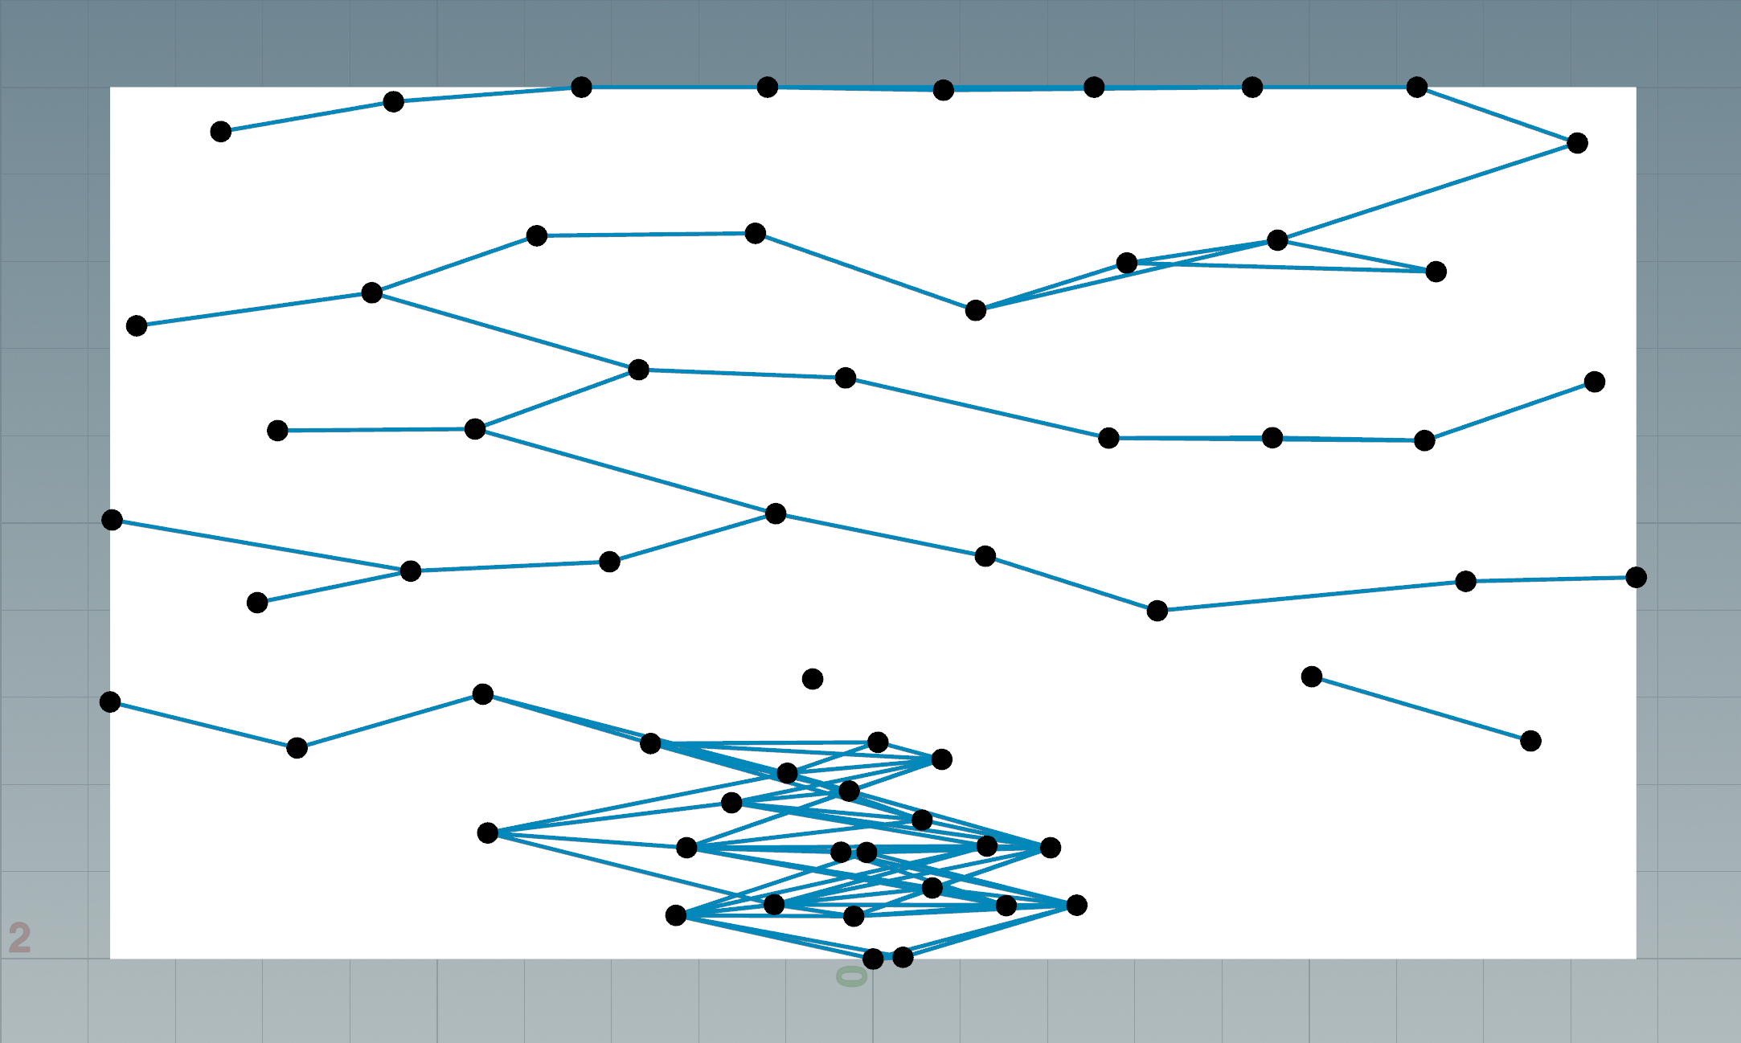
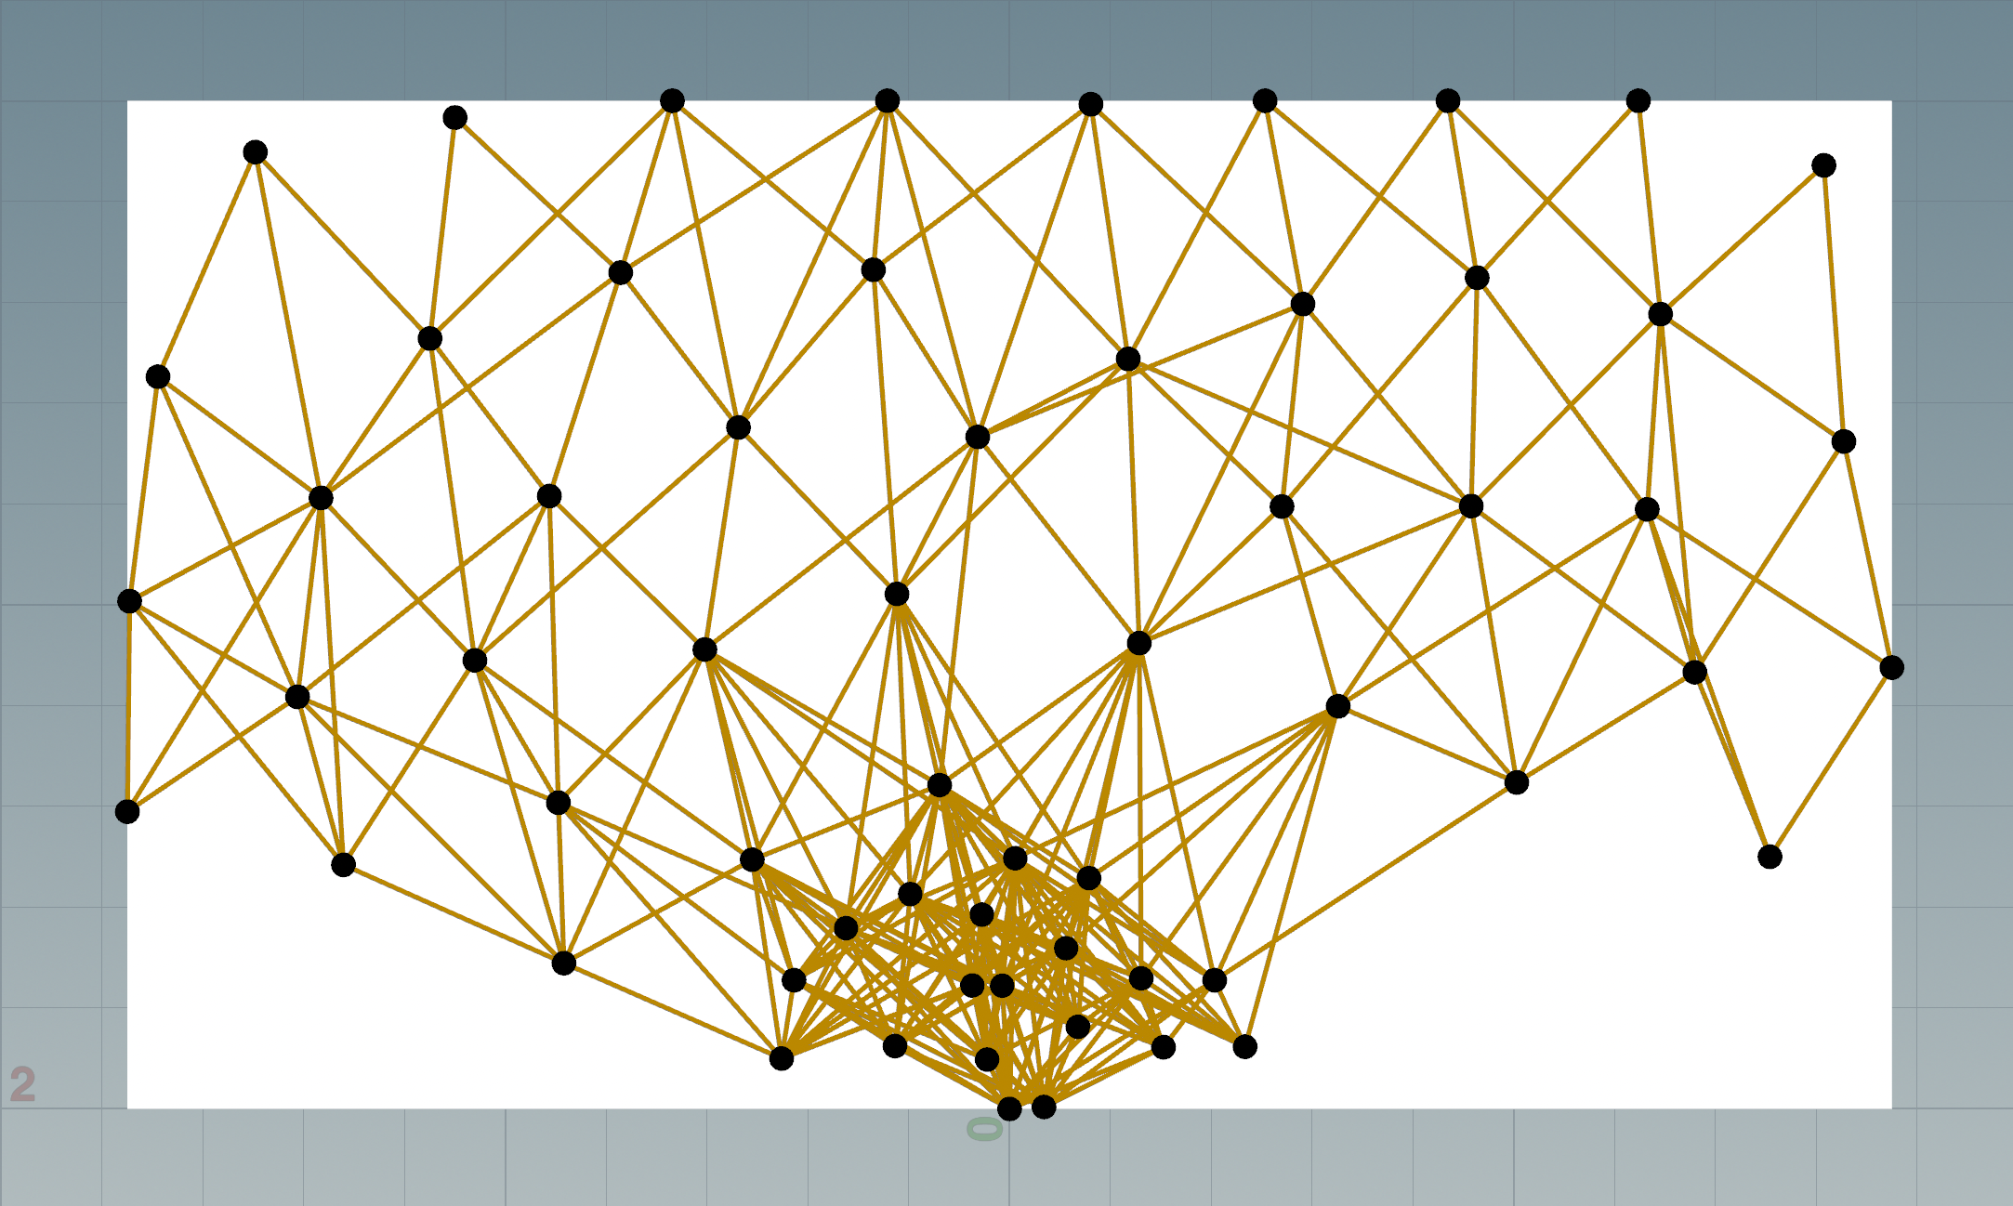
Roadmap graph construction
Edge generation
Generating directional edges satisfying distance and elevation constraints
Bidirectional edges satisfying low elevation constraint
Downward edges are generated between vertices not satisfying horizontal tiling constraint
Notes:
After vertex generation, directed Edges are generated between two vertices that satisfies two constraints: distance and horizontal tiling constraint.
The distance constraint is to limit the vertices to those near each vertex.
And, the horizontal tiling constraint limit the elevation angle of edges within certain range.
---- button -----
Due to these two constraints, bidirectional edges are generated when the horizontal tiling constraint is satisfied.
---- button -----
And, Downward edges are generated between vertices not satisfying horizontal tiling constraint
---- button -----

Slide 15
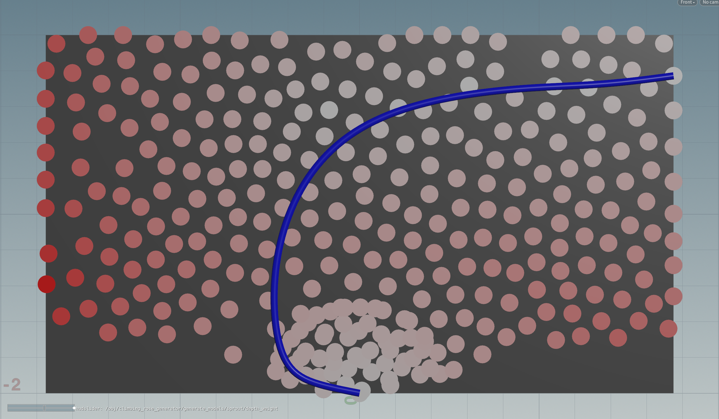
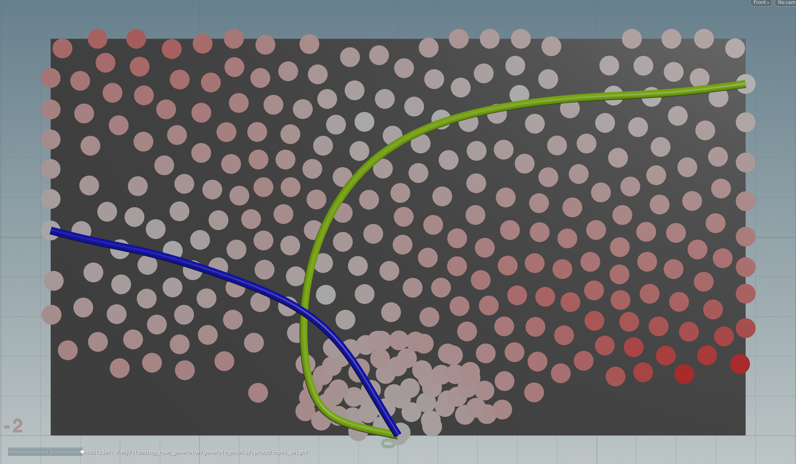
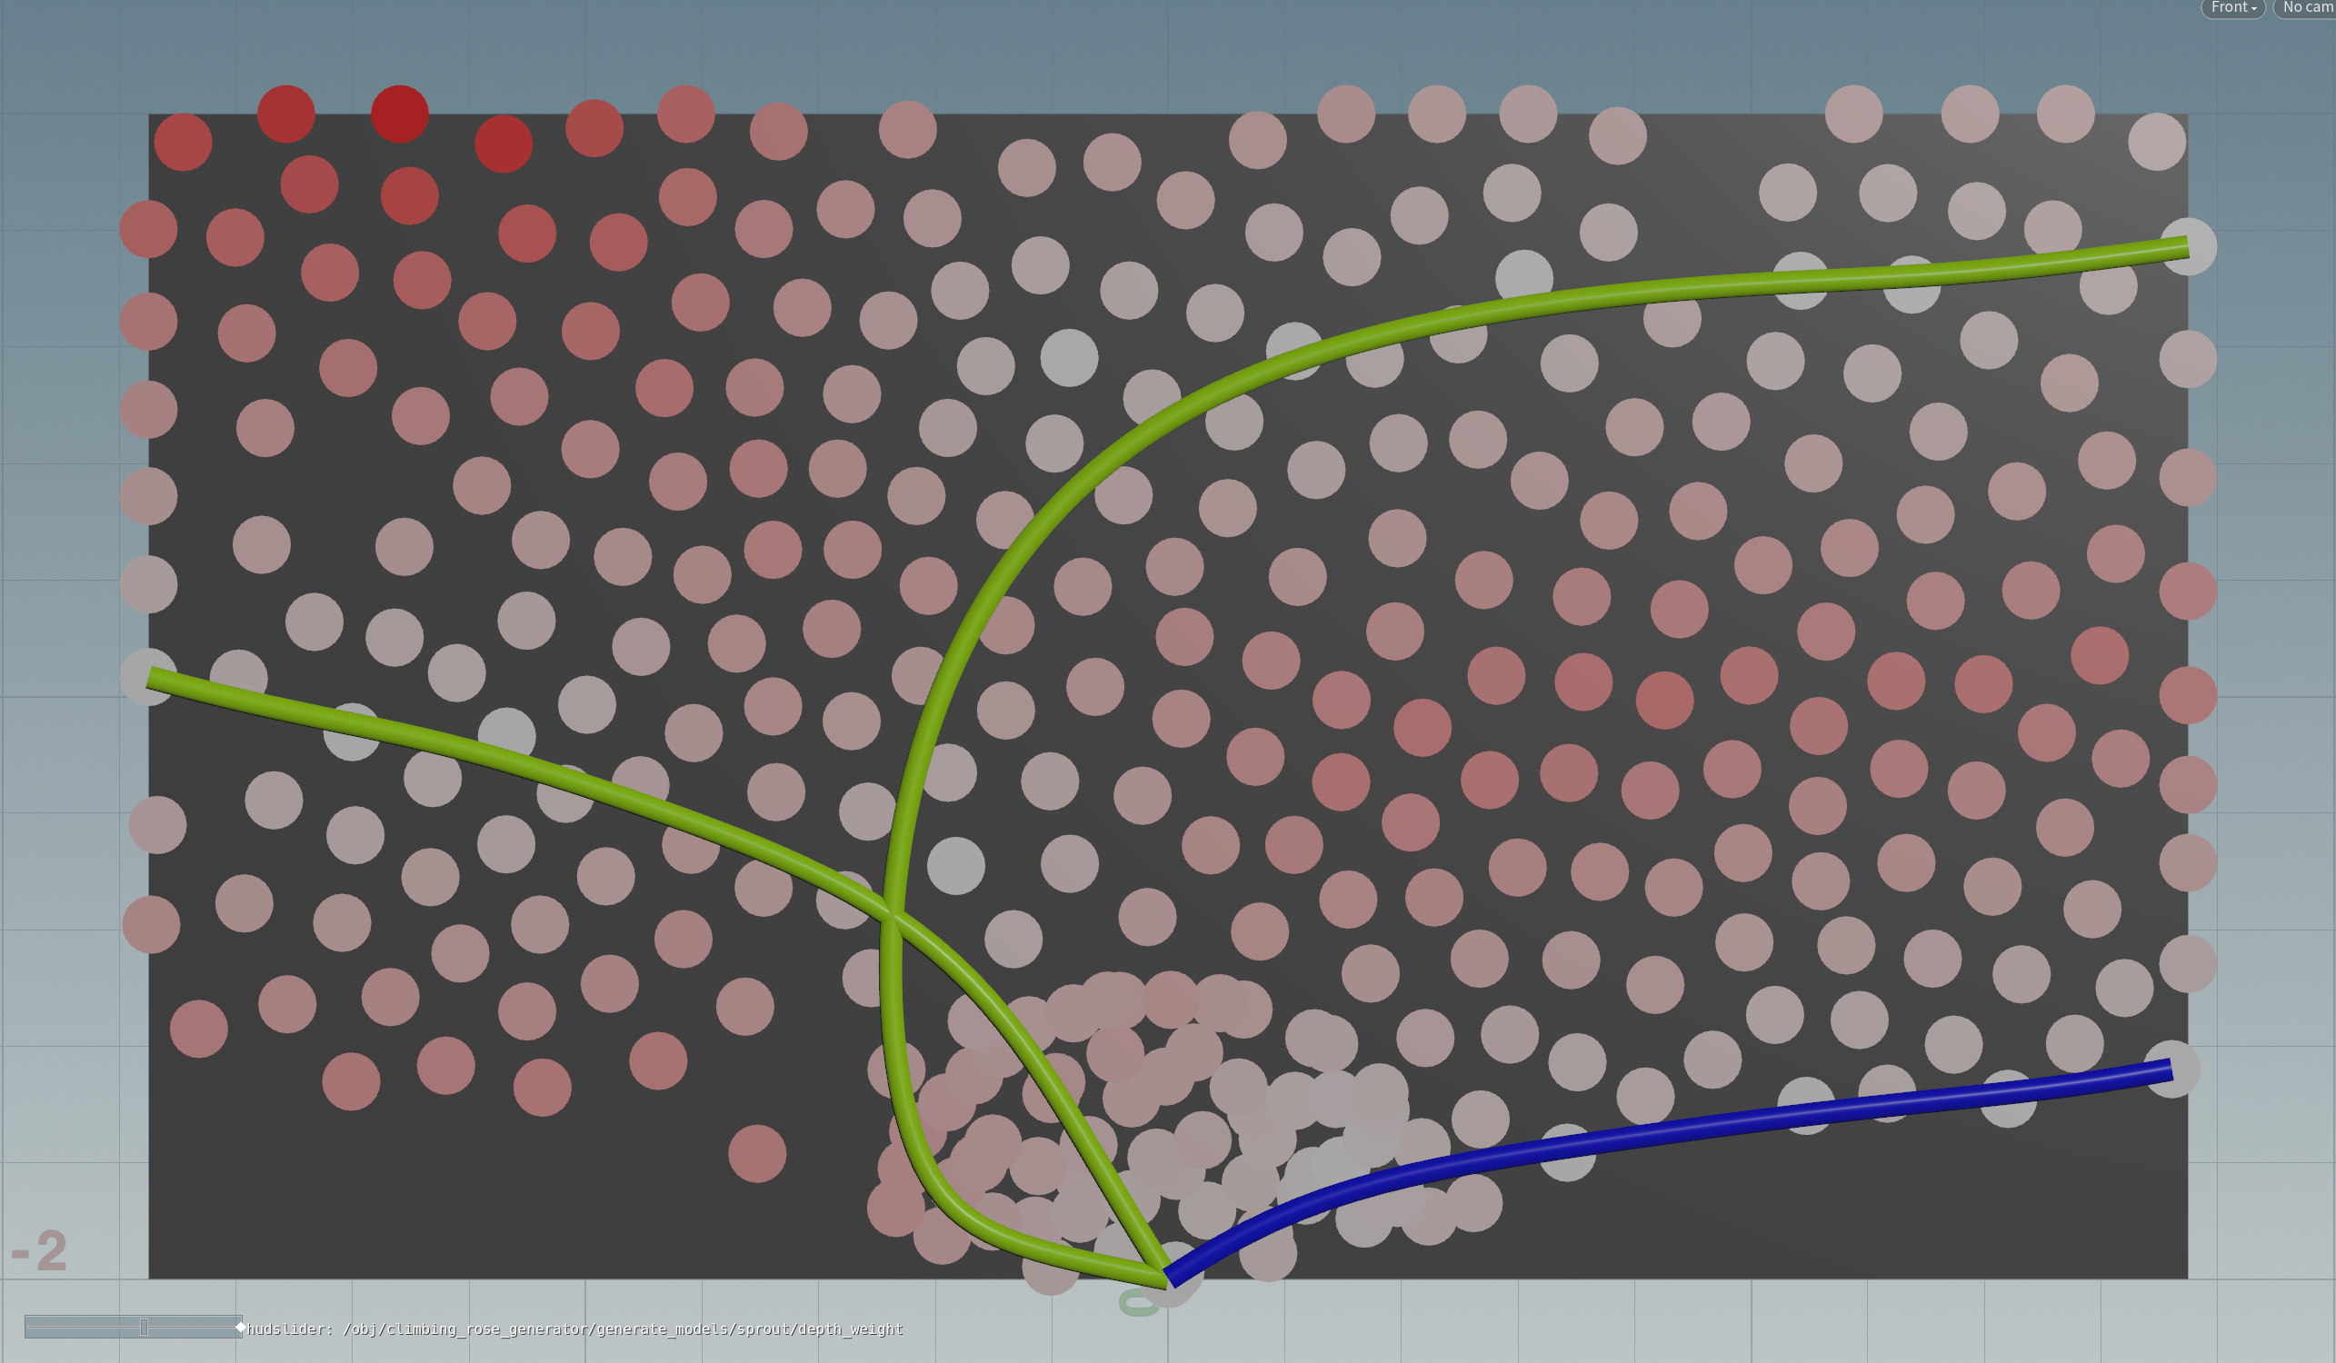
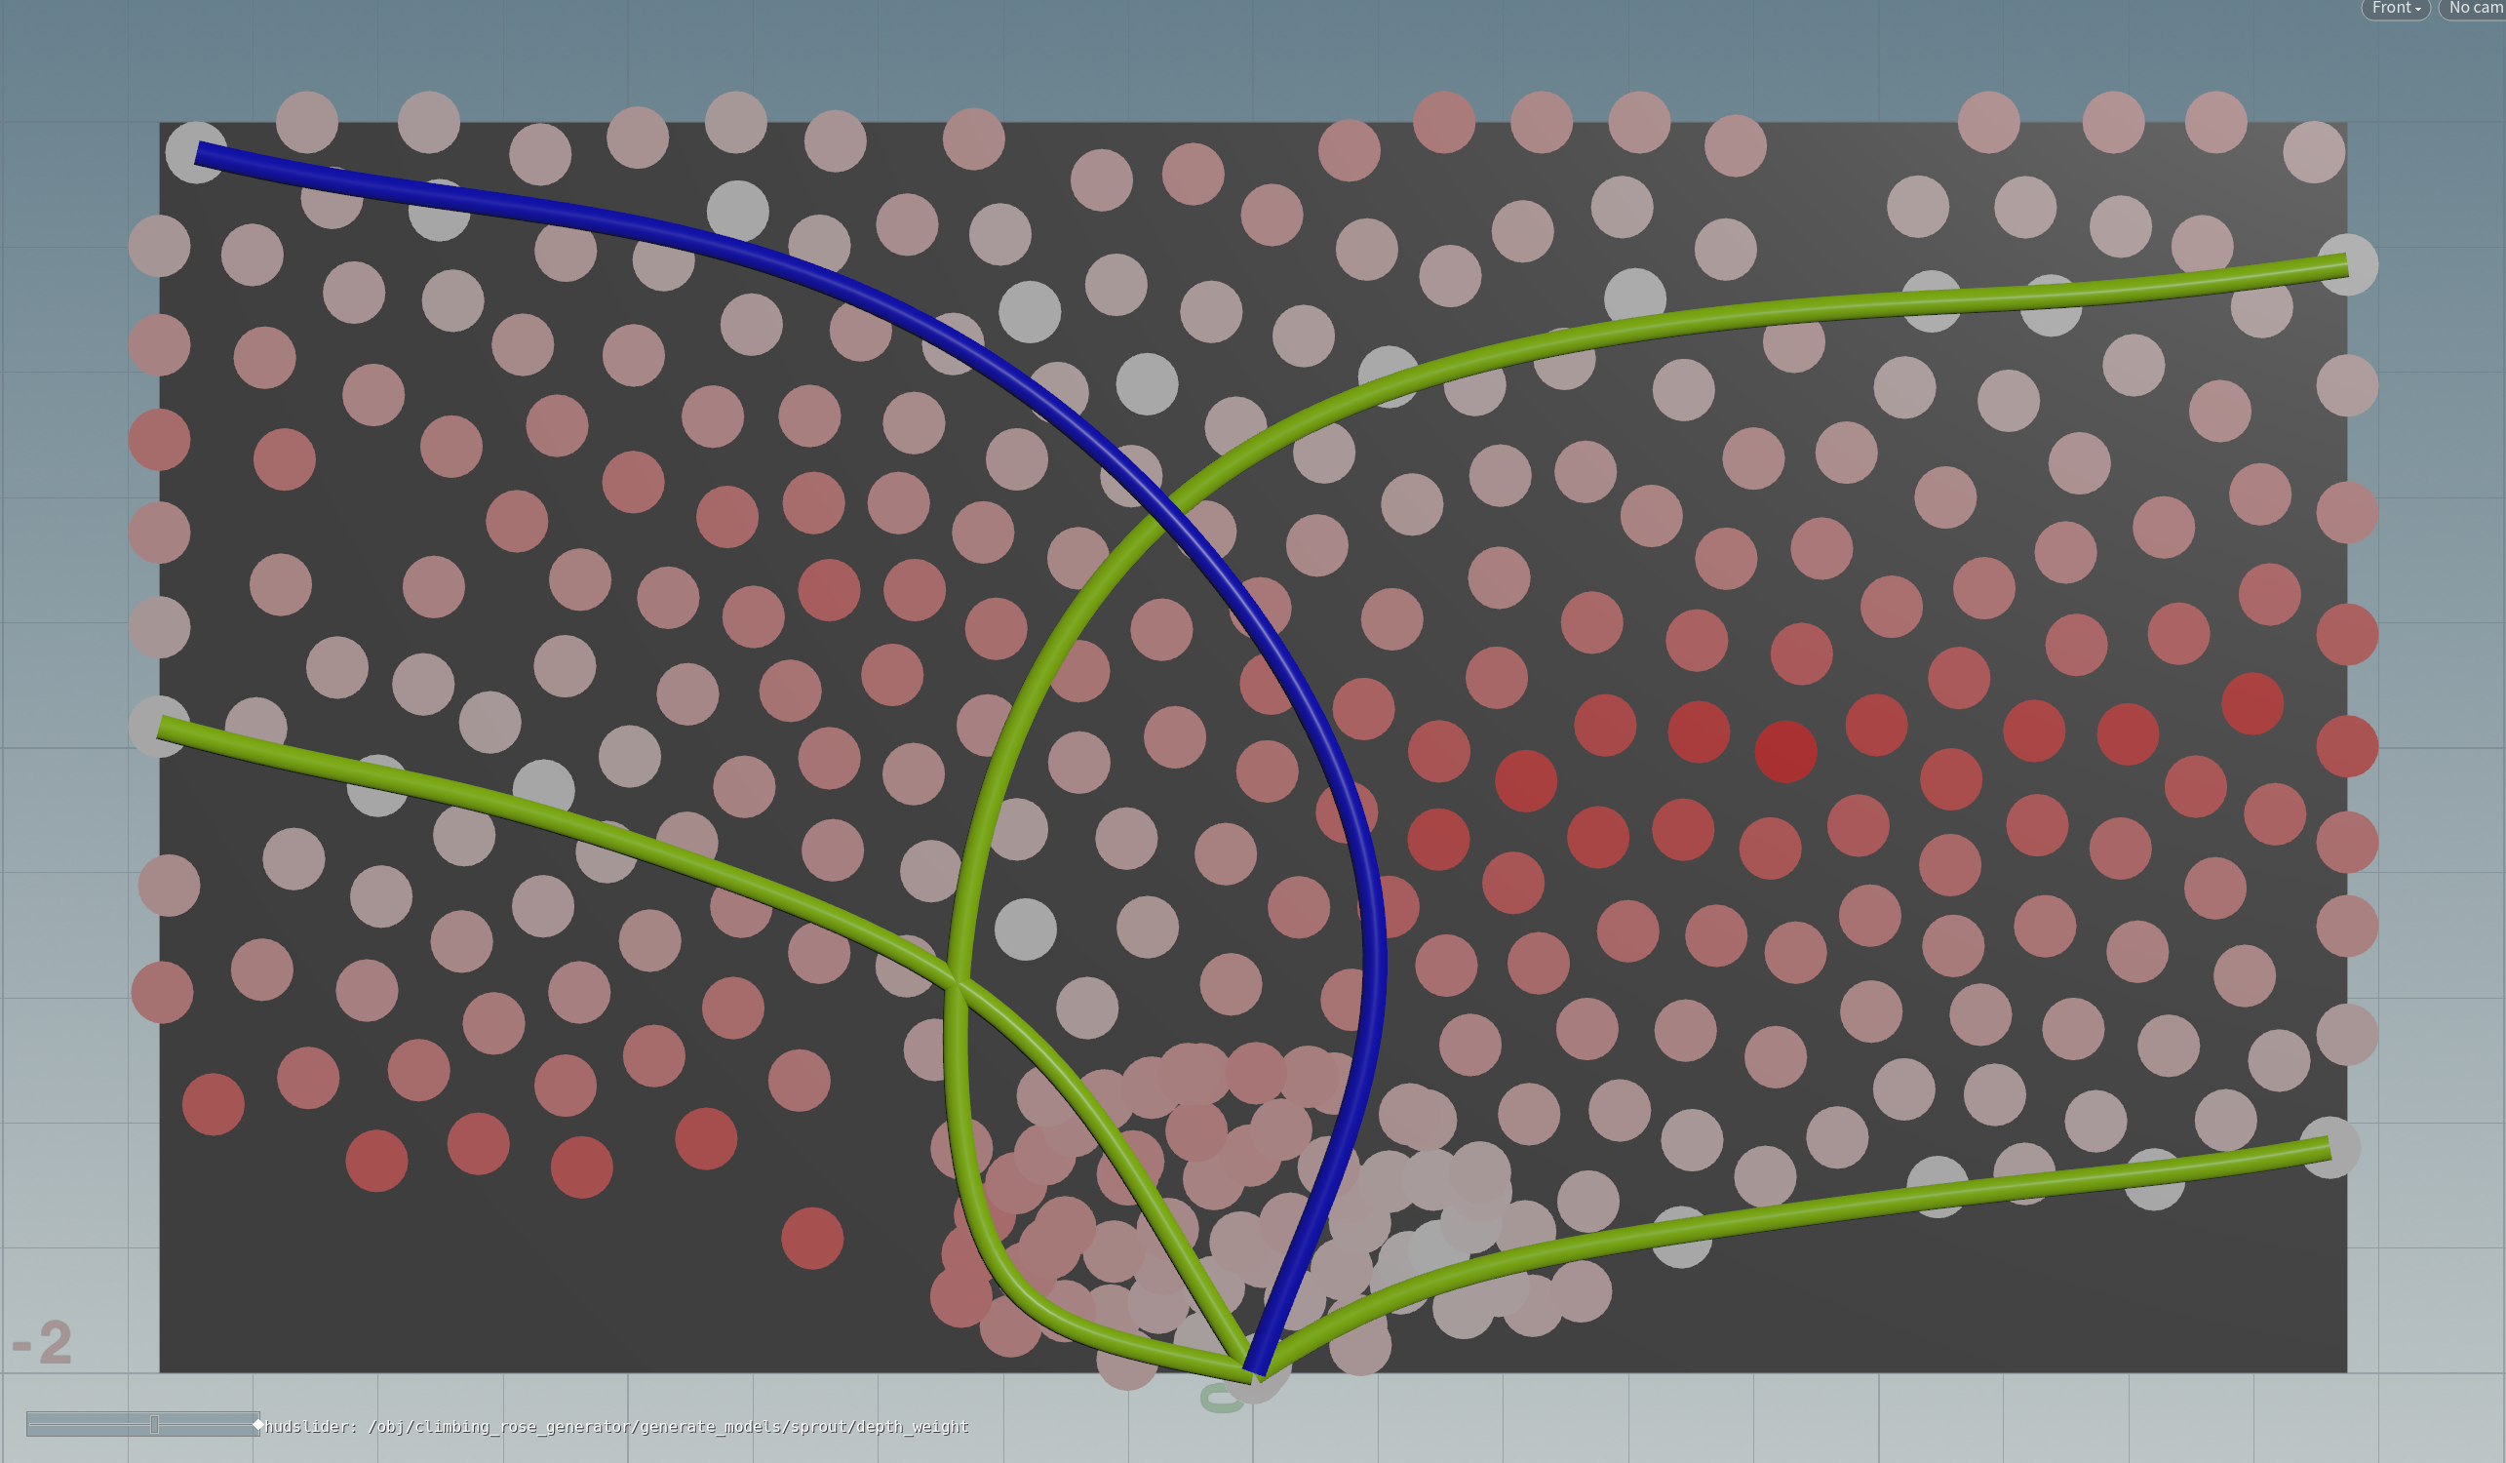
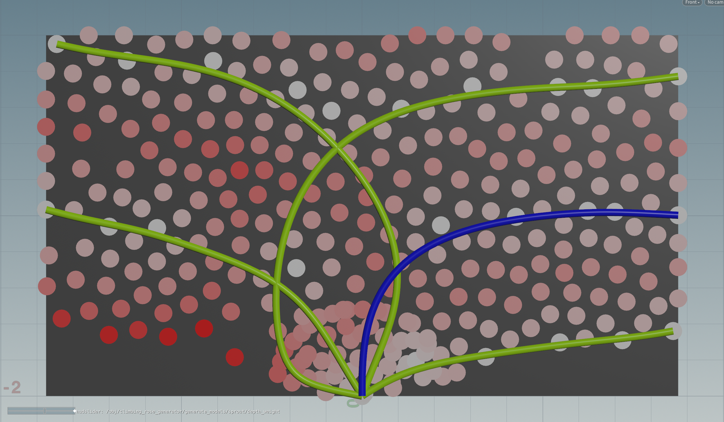
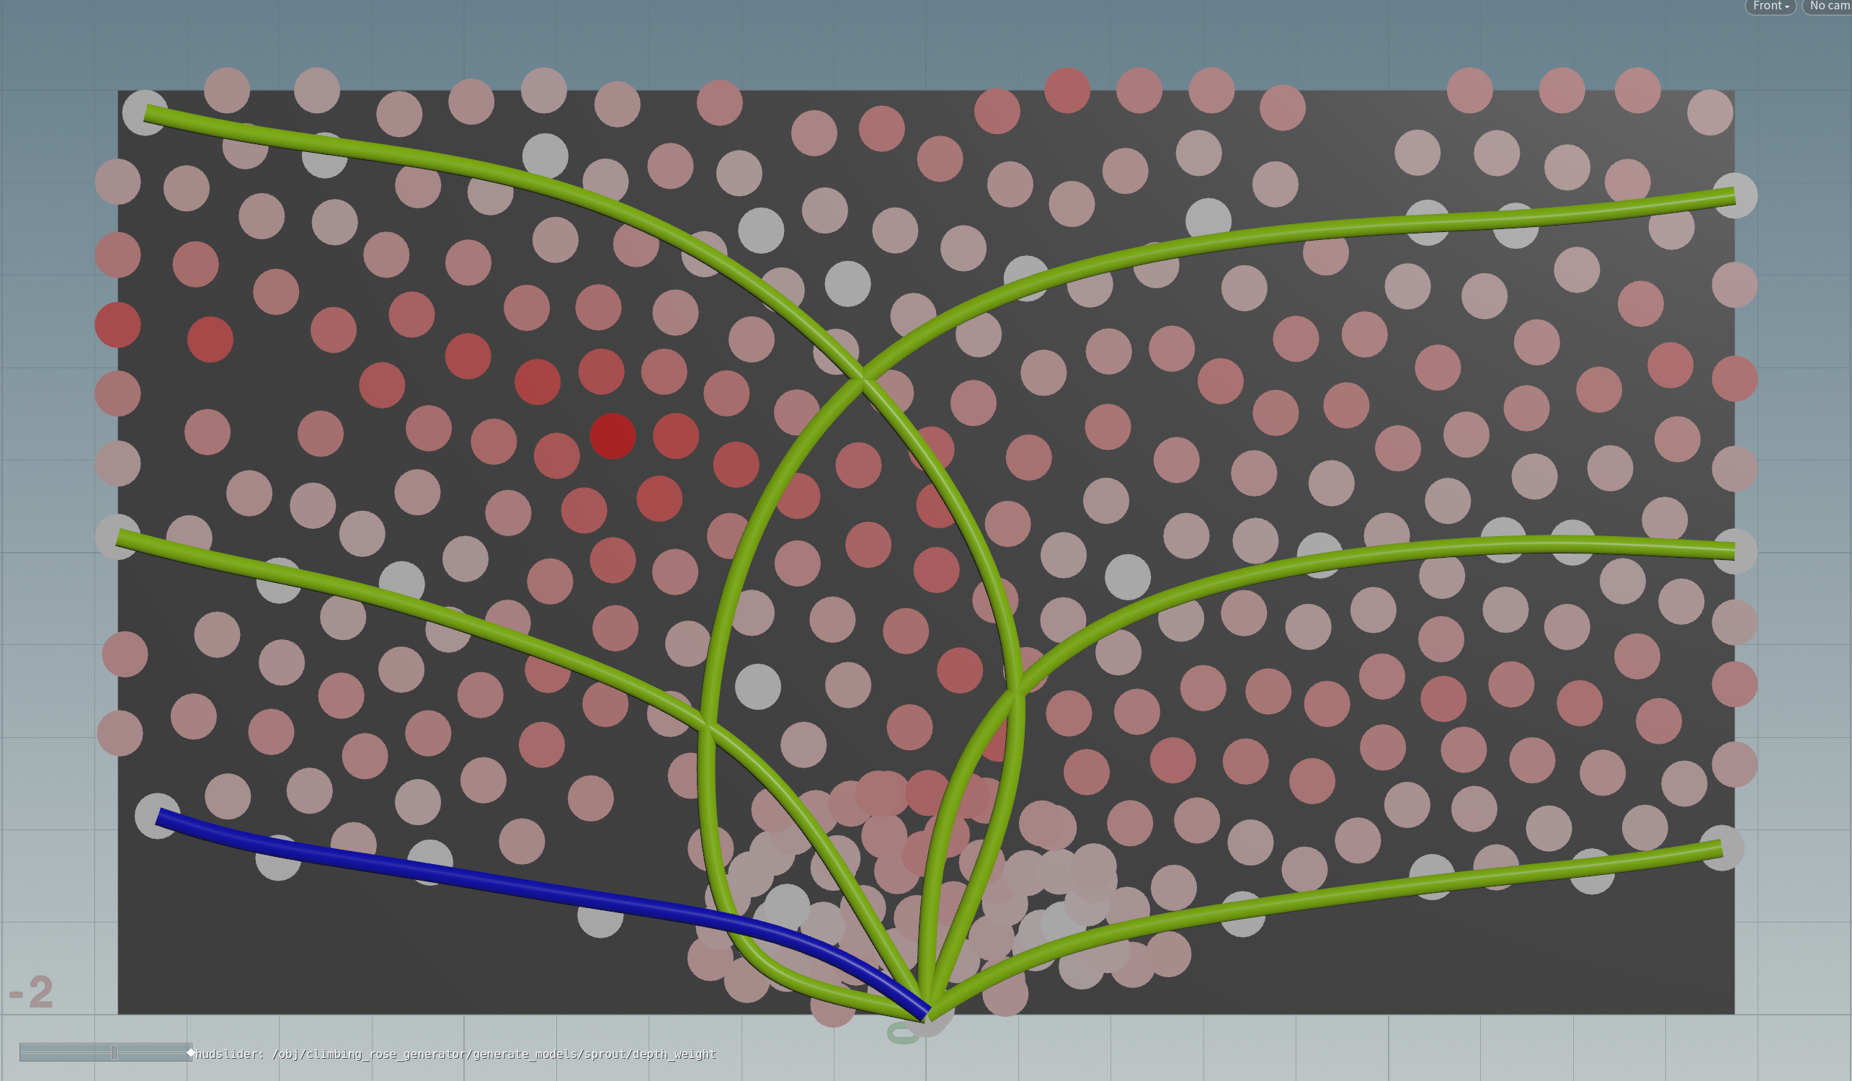
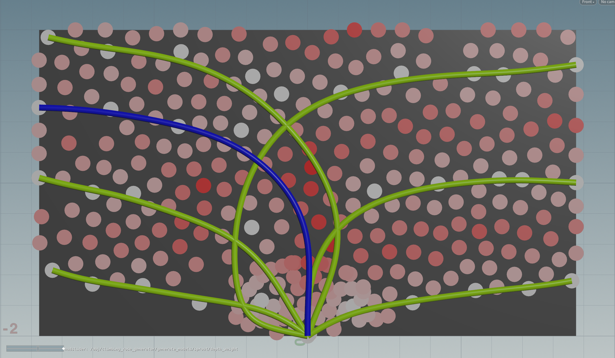
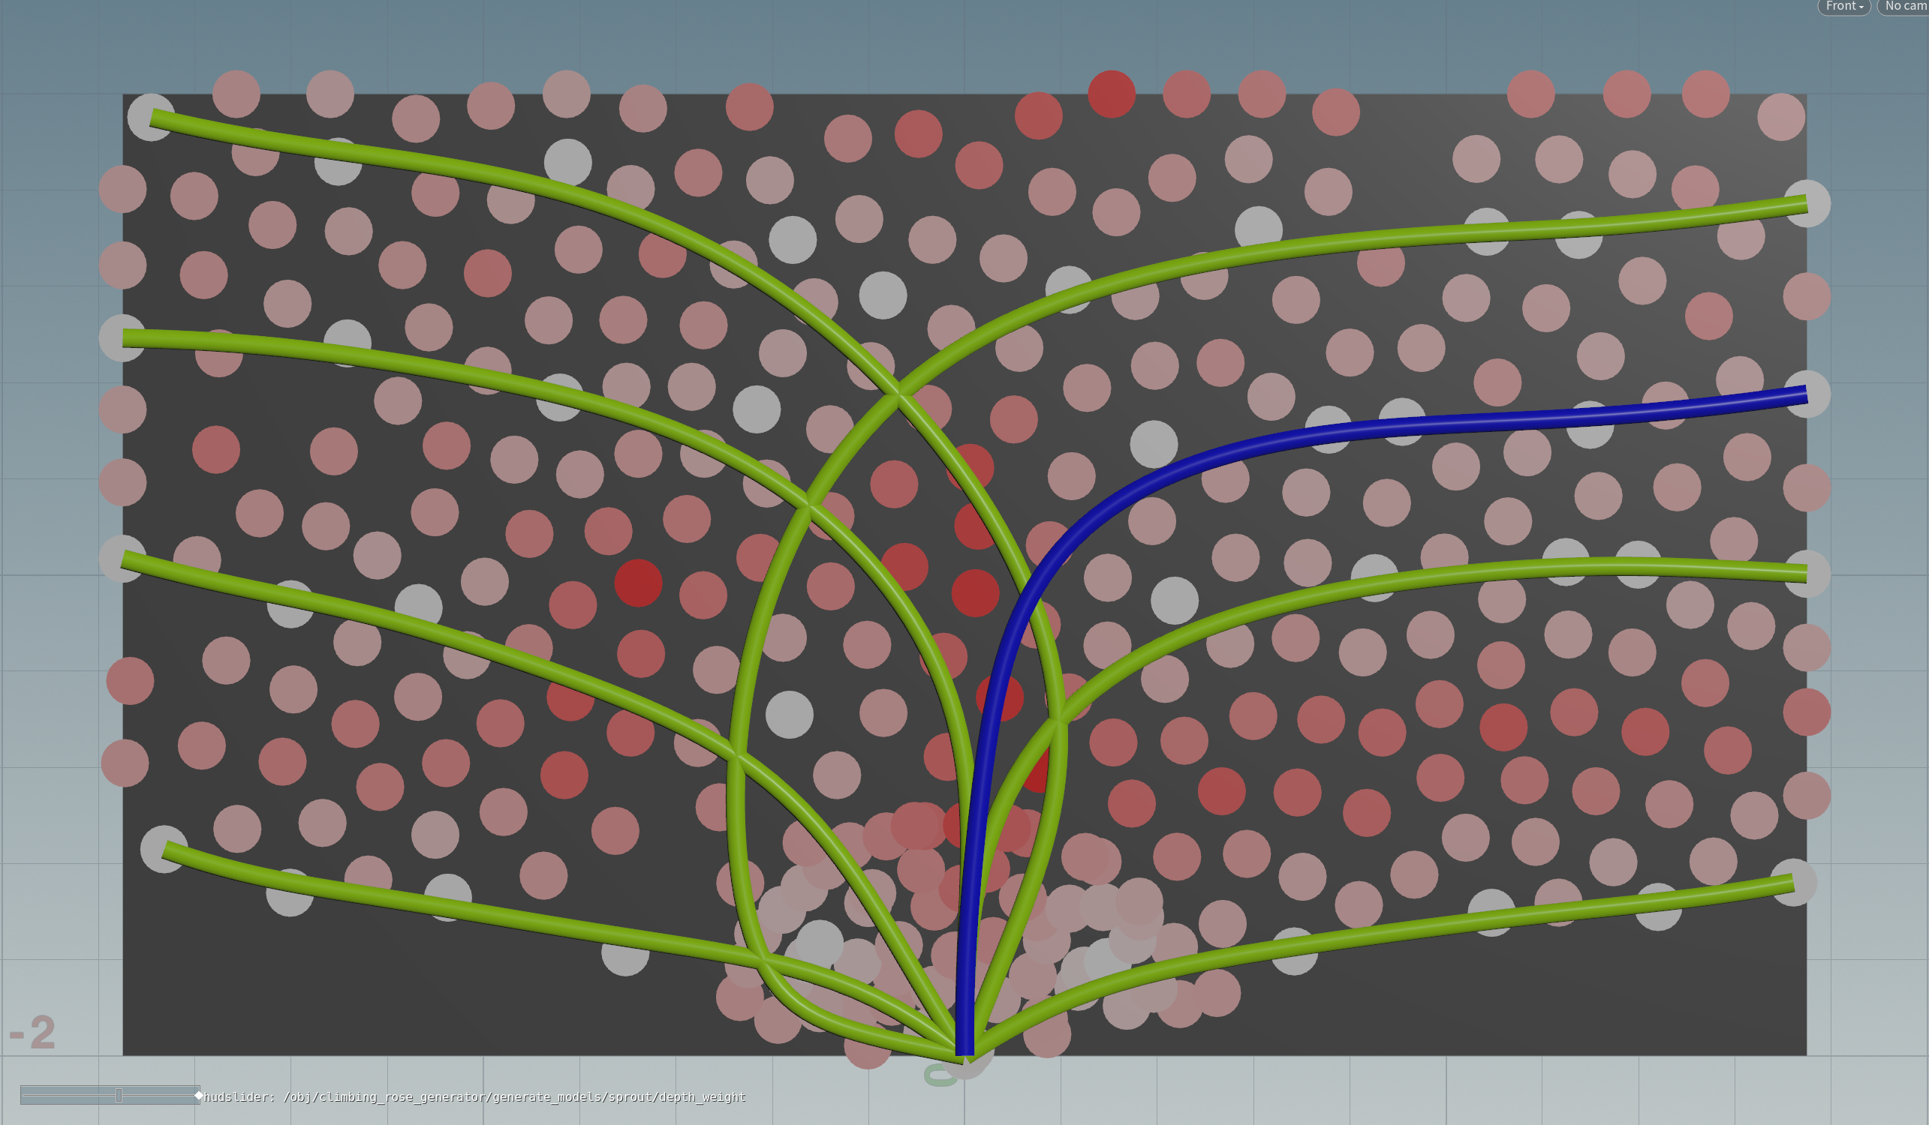
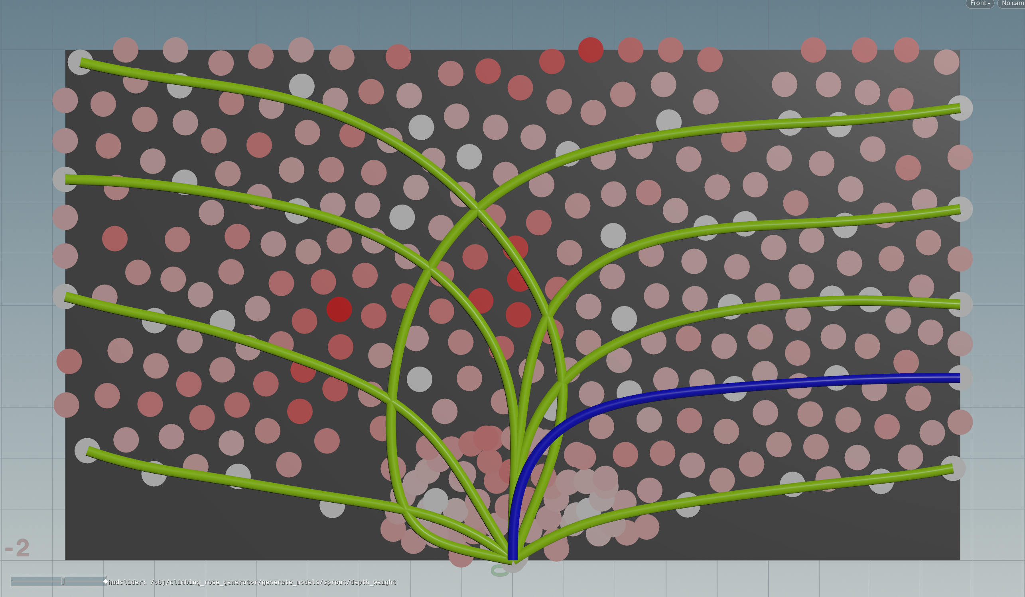
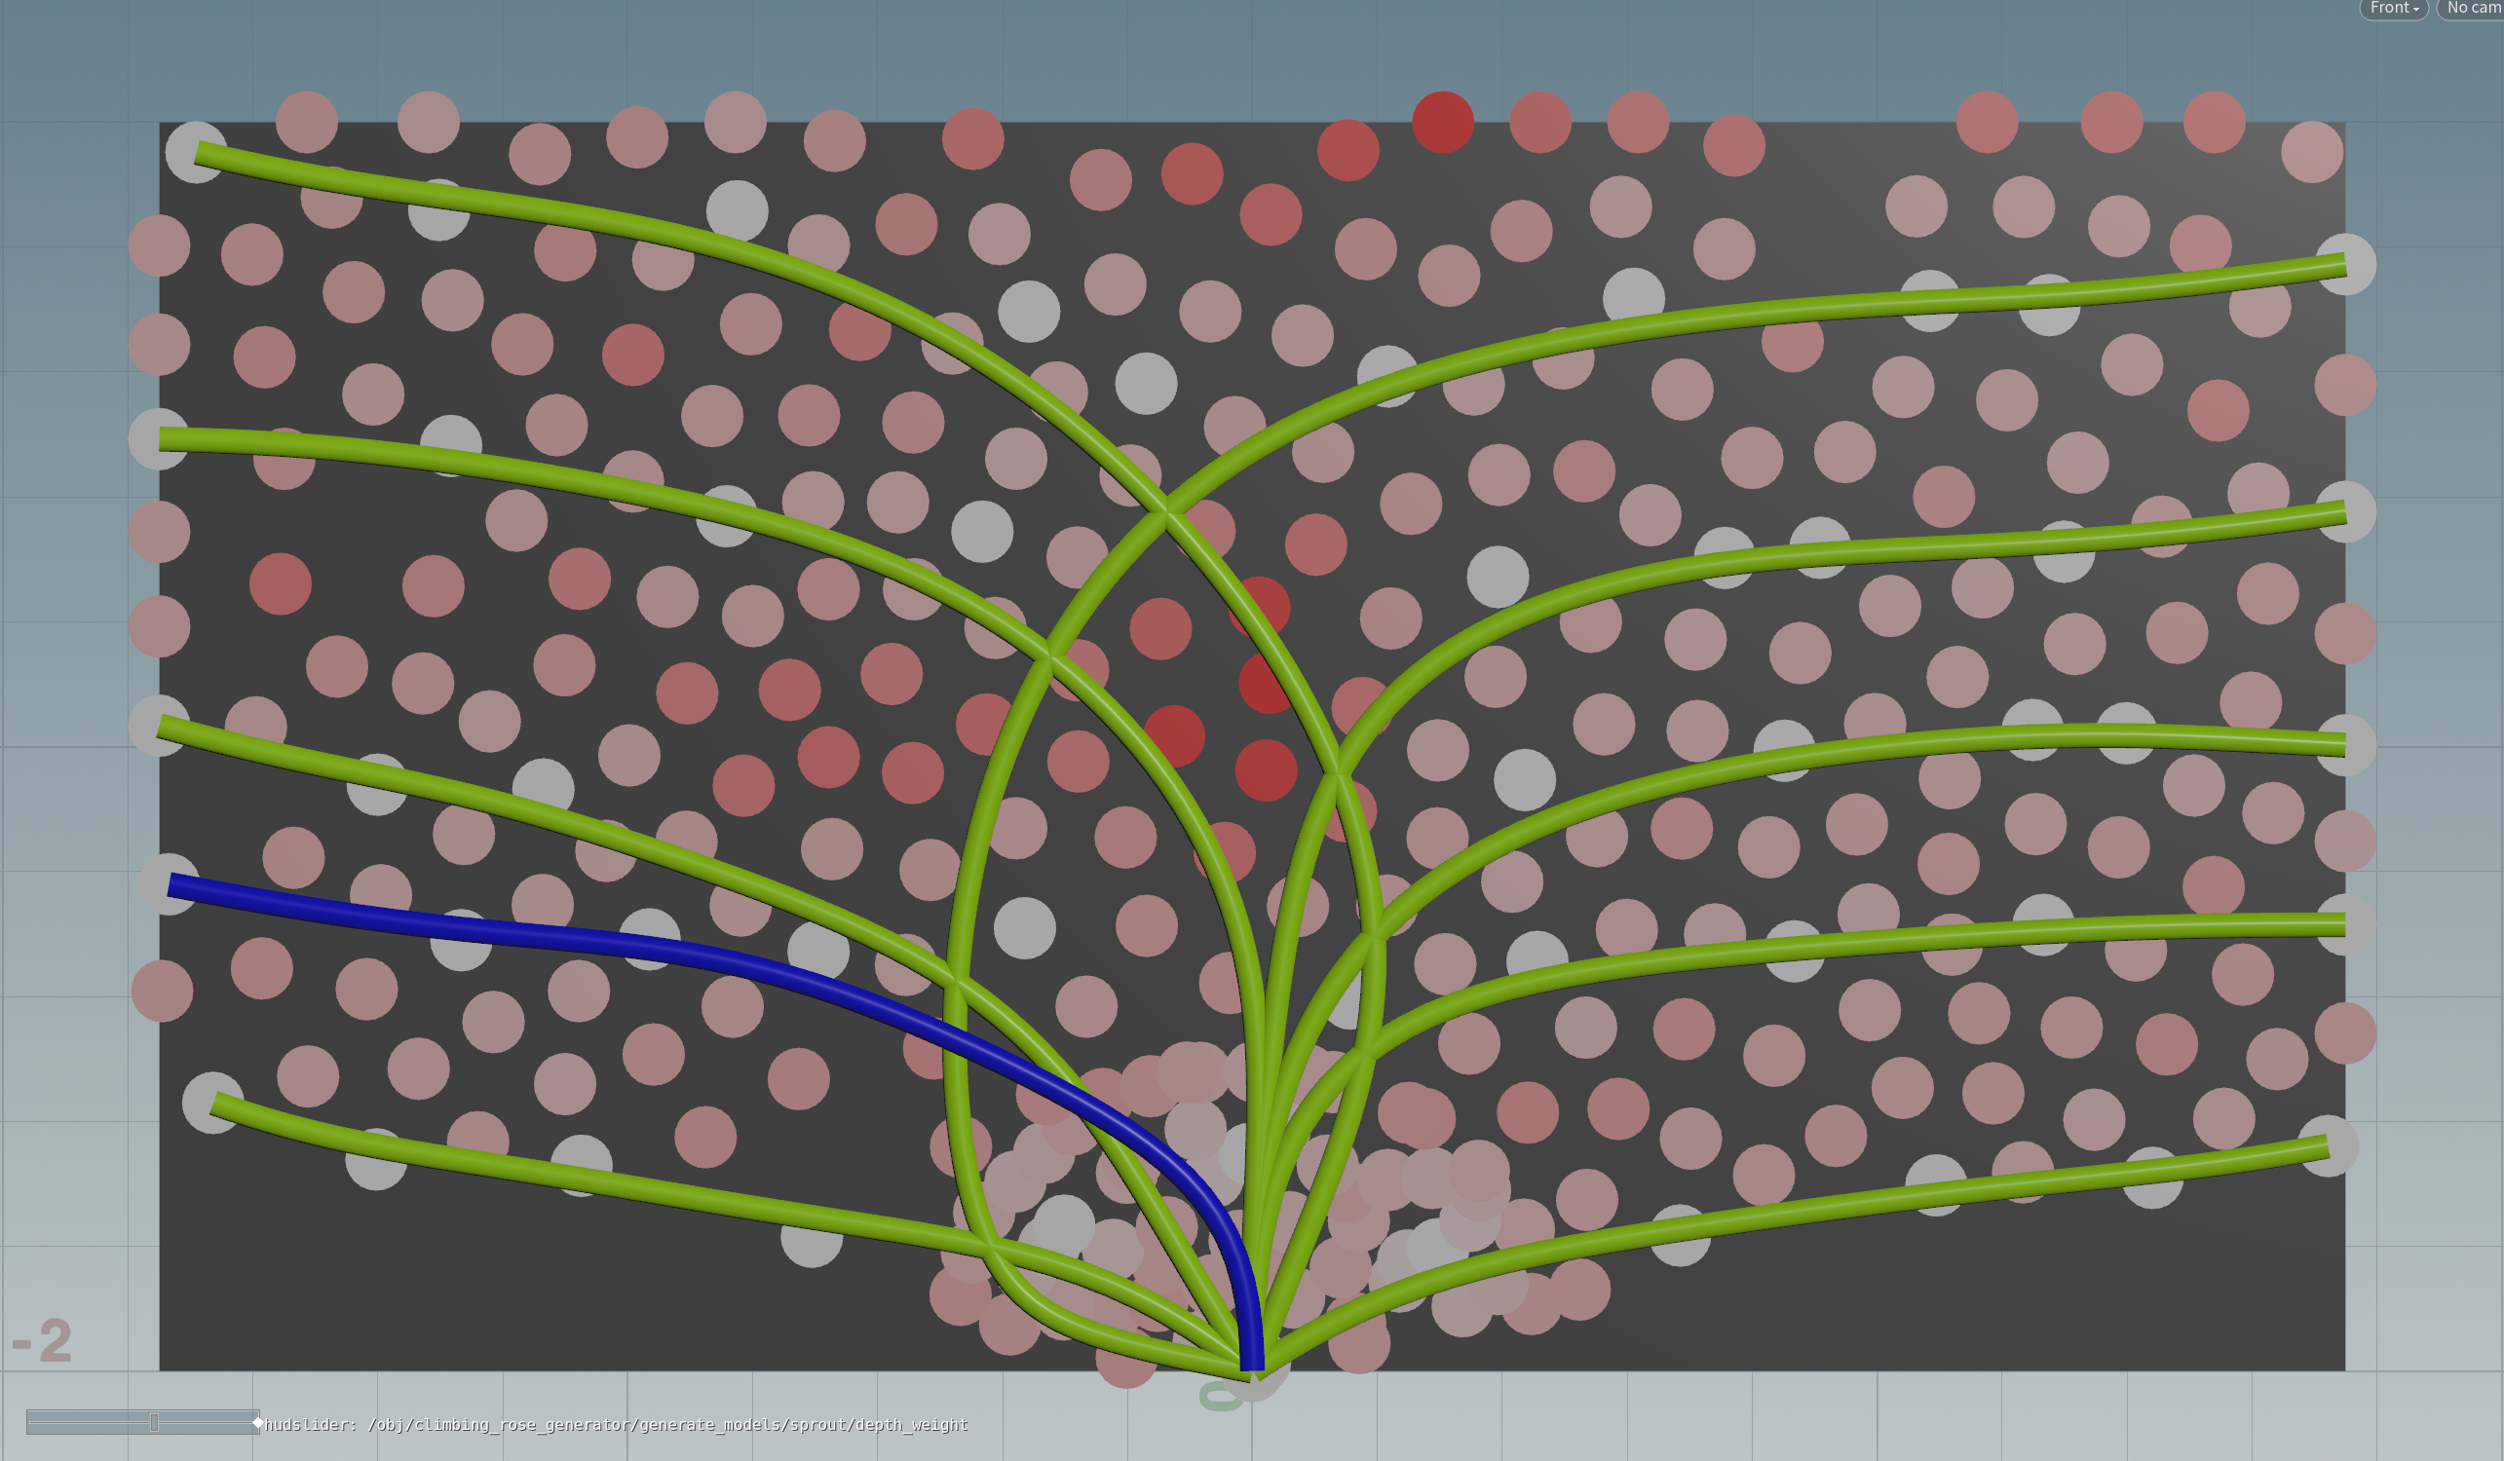
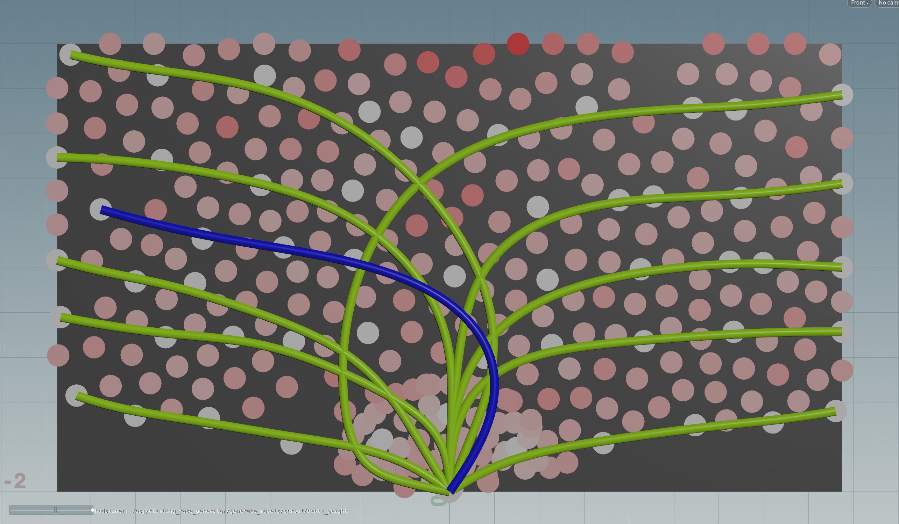
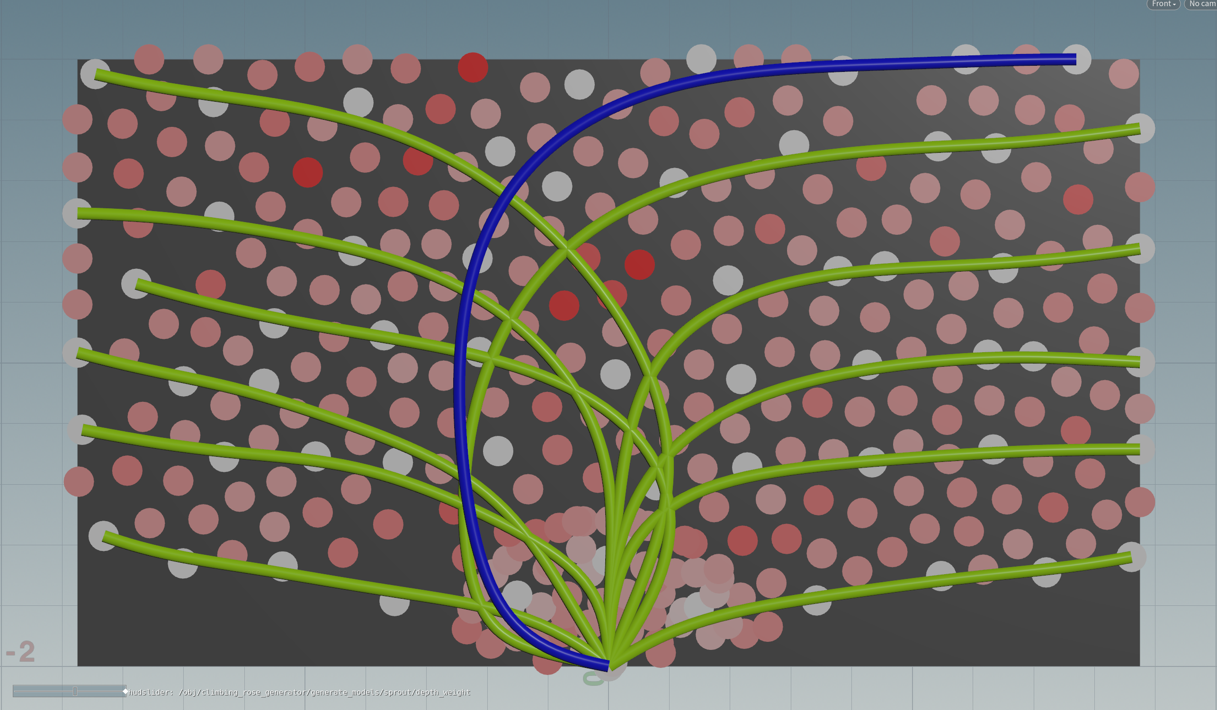
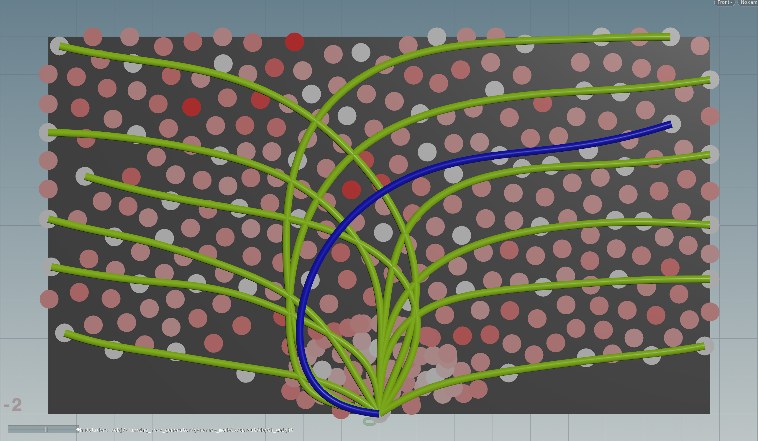
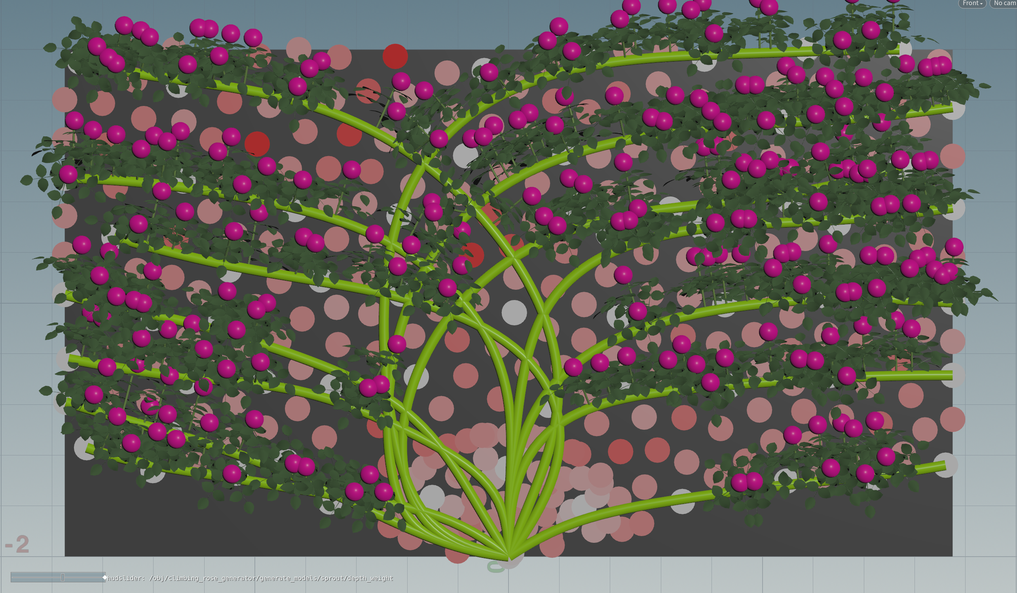
Iterative stem generation
Spaced arrangement
Horizontal tiling
Smooth curve
Method : Iterative path finding using Dijkstra Algorithm
Steps of each iteration
1. Calculate sparsity
2. Determine stem tip
3. Solve path finding
Empty
Sparsity estimate
Crowded
Notes:
After constructing the Road map graph, the proposed method iteratively finds optimal path on the graph and generates stems along the paths.
----- button ------
This movie shows the generation process.
Each iteration consists three steps.
First , Calculate sparsity to make Spaced arrangement
In the movie, The white and red circles represent sparsity.
Second, Determine stem tip.
Finally, Solve path finding using Dijkstra algorithm.
.
This pathfinding is based on three training criteria, (---button---) as shown in the top right corner.
----- button ------
(右上に各スライドで説明している要素がどの基準をもとにしているか、右上に表示していることを伝えたい) ←↑のセリフに加えたくらいで、長く言わなくても良いと思います。
The top right-hand corner of each slide indicates which training criteria the element discussed on that slide is based on.

Slide 16
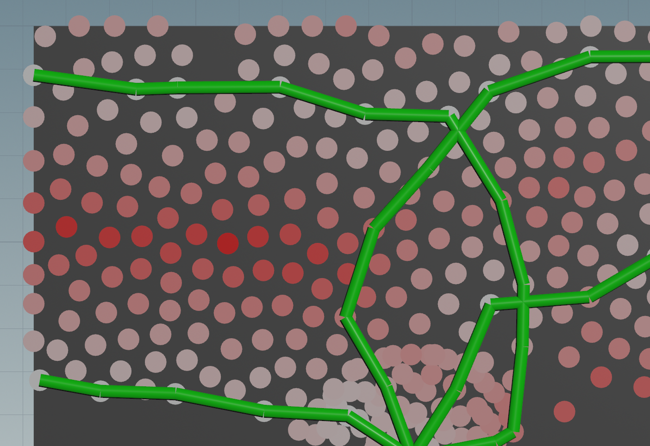
Branch sparsity ($s_{i}$)
Spaced arrangement
Horizontal tiling
Smooth curve
Sparsity($s_{i}$) is calculated in each vertex for spaced arrangement
Sparsity represents the shortest geodesic distance from the stems that are arranged horizontally
Normalized values are used among all vertices
Sparsity of each vertices
Red vertices are high sparsity
Notes:
At the beginning of each iteration, Sparsity is calculated at each vertex for Spaced arrangement
The sparsity represents the shortest distance from the stems that are arranged horizontally (わかりやすさ優先で修正しましたがどうですか？)
---- button -----
The vertices that satisfy the horizontal tiling constraint are shown by the yellow circle.
The further away a vertex is from already placed stems, the higher the sparsity, and the new branch will pass through the vertex with the higher sparsity.
---- button -----
Then, Normalized values are used among all vertices

Slide 17
Stem tip location
Spaced arrangement
Horizontal tiling
Smooth curve
The new stem tip position is identified by greedy search
$i^{∗}$ which maximizes the following objective function
$$i^{∗}=argmax σ_{0} s_{i}+σ_{1}d_{i}+σ_{2}U_{[0,1]}$$
Sparsity
Distance
Random value
$d_{i}$ reparasent place the stem tip distant from the root
$μ\left(≤1\right)$ reducing vertical effects
$d_{i}=\left\|{(v}_{i}−v_{root})\left[\begin{matrix}1 & 0 & 0 \\ 0 & μ & 0 \\ 0 & 0 & 1\end{matrix}\right]\right\|$
Tip position
Support wall
Stem
Root position
Notes:
the new stem tip is located by greedy search.
It is determined by the vertex that maximizes the objective function shown here.
This objective function is a weighted sum of three terms
The first term represents the sparsity, and the last term is random value.
------- button ---------
------- button ---------
The second term represents the distance from the root.
This term is expressed by the following formula.
In the scaling matrix, µ is reducing vertical effects.

Slide 18
Edge costs
Spaced arrangement
Horizontal tiling
Smooth curve
The edge cost ($C_{i,j}$) is shown by the following formula
$$C_{i,j}= α_{0} \left\|v_{i} − v_{j}\right\|+α_{1}(1 − s_{i})+α_{2}Ω(i)$$
$\left\|v_{i} − v_{j}\right\|$ : distance
$\left(1 − s_{i}\right)$ : sparsity
$Ω\left(i\right)=|Ω_{H}\left(i\right)Ω_{L}\left(i\right)|$
$Ω_{H}\left(i\right)$ : horizontal
$Ω_{L}\left(i\right)$ : overhang
$Ω_{H}\left(i\right)$
Stem tip
$Ω_{L}\left(i\right)$
root
Notes:
The weight of the edge through the i-th and j-th vertices is given by the formula shown here.
The first term represents the distance between two vertices.
and the second term represents the sparsity.
This term takes smaller values for higher sparsity, and reduces the weight of edges in unplaced areas
Then the last term makes the stem shape.
The Omega_i consists of two functions.
The first function make horizontal tiling.
The second function creates an overhanging stem shape on the opposite side of the branch tip to the root position.

Slide 19
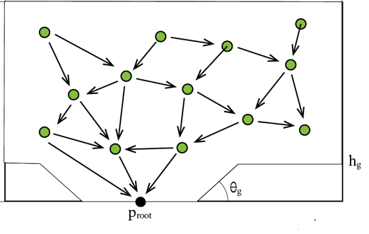
Constrained path finding
Spaced arrangement
Horizontal tiling
Smooth curve
The Dijkstra Algorithm is used for the path finding
However, smooth constraint restricts the combination of edges
Sharp connected edge combinations are excluded
Avoid sharp path
Notes:
The Dijkstra Algorithm is applied for the path finding
In this step, smooth curve constraint is also imposed to restrict the combination of edges on the roadmap graph
Combinations where two edges are sharply connected are excluded to avoid sharp stem bend.

Slide 20
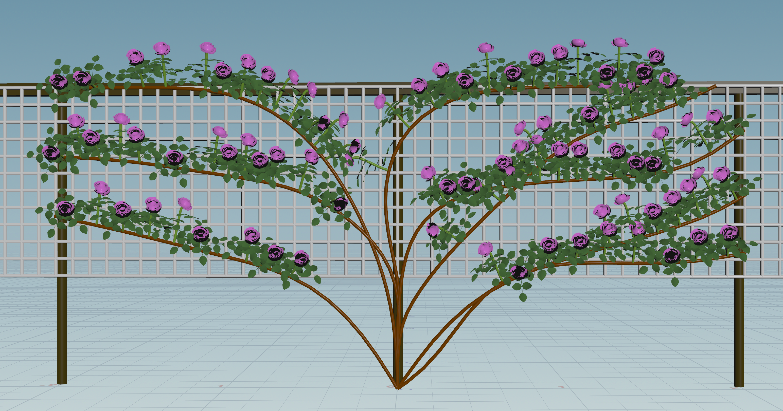
Experimental results
Photograph
Generated result
Multiple stems are arranged with space
Flowers lining up on horizontally trained stems
Notes:
Next, I will explain the Experimental Results.
The figure on the left shows a photograph of real climbing rose, and the right shows the results generated to mimic it.
Multiple stems are arranged with space.
Similarly to the left climbing rose, Flowers lining up on horizontally trained stems

Slide 21
Difference by the number of vertices
Constrained Roadmap
vertices
Stems
50
300
800
Result
Notes:
This Figure shows the difference in the number of roadmap graph vertices. from left to right.
The left result is failed due to insufficient number of vertices as shown in the roadmap graph
Also, the results on the right are too smooth.
Therefore, The choice of the number of vertices is important to produce natural results.

Slide 22
Difference by the wall shape
Notes:
This Figure shows the difference by the wall shape
The proposed method successfully produced convincing stem arrangements for arbitrary wall sizes.
However, there were fewer branches growing horizontally on the vertical wall, resulting in fewer flowers and leaves, as shown on the left side.
To avoid this problem, the gardener actually increases the horizontal portion of the branch , by widening the branching of the stem , or by fixing the branch to the wall in an S-shape, both of which are not considered in the proposed method.

Slide 23
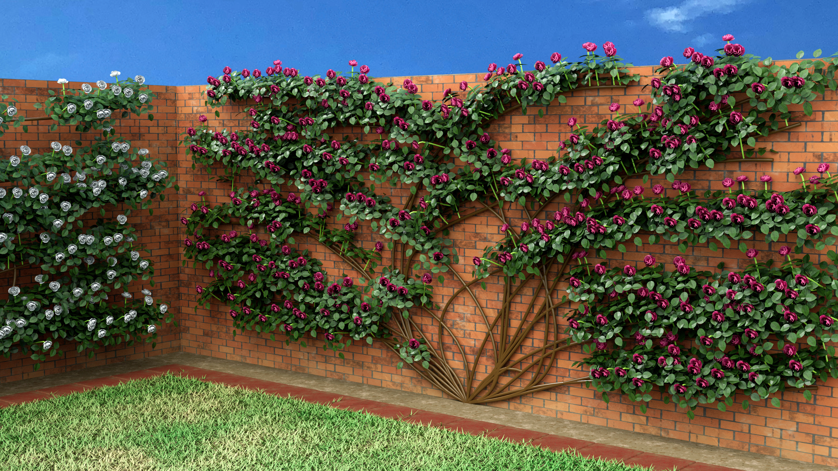
Rendering result and interview with rose experts
Professionals Evaluation
✓
Training criteria
(❌ variety-specific training)
❌
Flat around the root
Same flowers and leaves model
Branching
Notes:
This figure is a rendering result.
We also conducted subjective evaluations through interviews with rose experts to identify the limitations.
The three training criteria are valid, and the generated results satisfy them.
But, additional criteria, such as variety-specific training, were also suggested for more convincing results.
They also pointed out some shortcomings in the results
For example, Stems near Root should be three-dimensional.
They also suggested that the flower shapes should vary for each individual, considering differences in flowering time and speed
Moreover, They suggested the introduction of branching in the main stems to improve the visual quality

Slide 24
Conclusion
Propose the procedural modeling method for climbing roses
The proposed method is based on the artificial care training
Limitation :
Supporting structures are only 2D wall
Stem roots are always the root position
Future work :
Address these limitations to improve the quality
Interactive operations
Notes:
In summary, we have proposed the procedural modeling method for climbing roses
The proposed method is based on the artificial care called training
However, the Supporting structures are only 2D wall, and, Stem roots are always the root position
In our future research, we plan to address these limitations in order to improve the quality of the generated tree of the system.
There is potential for the development of interactive operations such as controlling the density of branches by painting.

Slide 25
3.2.1 Sparsity
$s_{i}= \min_{e∈ε}{gdist (v_{i}, v_{e})}$
gdist(va, vb) represents the geodesic distance between va and vb on the roadmap graph where the elevation angle constraint is not imposed. E represents an index set of the stem tip vertices and the vertices on the stem path satisfying the elevation angleconstraint.
正規化する

Slide 26
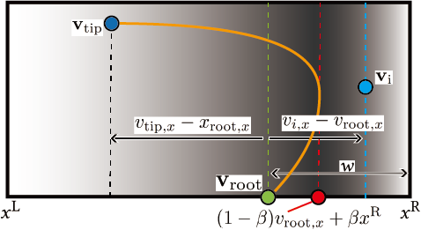
3.2.3. $Ω$(i)
$Ω\left(i\right)= \left|Ω_{L\left(i\right)}Ω_{H\left(i\right)}\right|$,
$Ω_{L}\left(i\right)= \frac{v_{i,y} −v_{j,y}}{\left|v_{i}−v_{j}\right|}$,
$Ω_{H}\left(i\right)=sign \left(v_{tip,x} −v_{root,x}\right)\frac{v_{y,x} −v_{root,x}}{W}+ β$,
$W= \left\{\begin{aligned}x^{R} −v_{root,x} if v_{i,x} ≥ v_{root,x} \\ v_{root,x} −x^{L} otherwise\end{aligned}\right.$

Slide 27
3.2.4. Constrained Path Finding
Spaced stems
Horizontal form
Smooth curve
Path finding using the Dijkstra algorithm
However, smooth constraint restricts the combination of edges
the inner product of two edges.
グラフのず
Gradually when curved
Near and Sharp
Not Sharp
Each vertex is far away.
Notes:
The Dijkstra Algorithm is used for the path finding
However, smooth constraint restricts the combination of edges
This constraint uses the inner product of two edges
The edges are not normalized when taking the inner product here.
This is because when the path is finally curved, the larger the two edges, the smoother it will be.

Slide 28
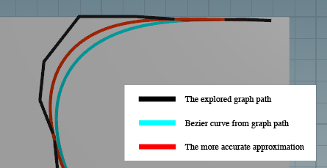
3.3. Smooth Stem Generation
Spaced stems
Horizontal form
Smooth curve
A smooth stem is generated as a Bézier curve P(t) from the explored graph path.
loses the sharp curvature of the graph path
Our method avoids this defect by adding the control points at the midpoint of each edge
$p\left(t\right)= \sum_{k=1}^{2N^{G}}{{{}_{N^{G}}^{}C}_{k}{ t}^{k}{\left(1−t\right)}^{N^{G}}b_{k} }$
$b_{k} = v_{\left\lfloor k/2\right\rfloor }$

Slide 29
4.1. Side Shoot Generation (Occurrence Position)
以下の３つの条件を満たすところからsideshootがでる
枝の先端から n%（n = user difine）
Smooth stem のなかで Elv constraint を満たす
らんだむvalue
先端は壁がない方にランダムに上向きででる
図
図

Slide 30
4.2. Side Shoot Generation
$N^{F}$個の節を再起的に生成
i番目の節の向き$q_{i}^{}$は加重平均で決まる
$$q_{i}^{}=\frac{q_{i−1}+\left(λ −\frac{i γ}{N^{F}}\right)[0, 1, 0]}{1+λ −\frac{i γ}{N^{F}}}$$
$λ$ ：光方向
$γ\text{ ：}重力方向（先端ほど強く）$
図

Slide 31
4.3. Pedicel
花枝の先端に花首をつける
１つの枝に最大３つの花首
花首は花枝の式に花の重さ$Ω^{F}$を追加
$q_{i}^{}=\frac{q_{i−1}+\left(λ −\frac{i γ}{N^{F}} −Ω^{F}\right)[0, 1, 0]}{1+λ −\frac{i γ}{N^{F }}b −Ω^{F}}$
図

Slide 32
4.4. Models
ユーザーが作った花と葉のモデルをつける
葉は養生に沿って螺旋状に花枝の書く節につける
花はpedicelの先端に
図

